Slide 1
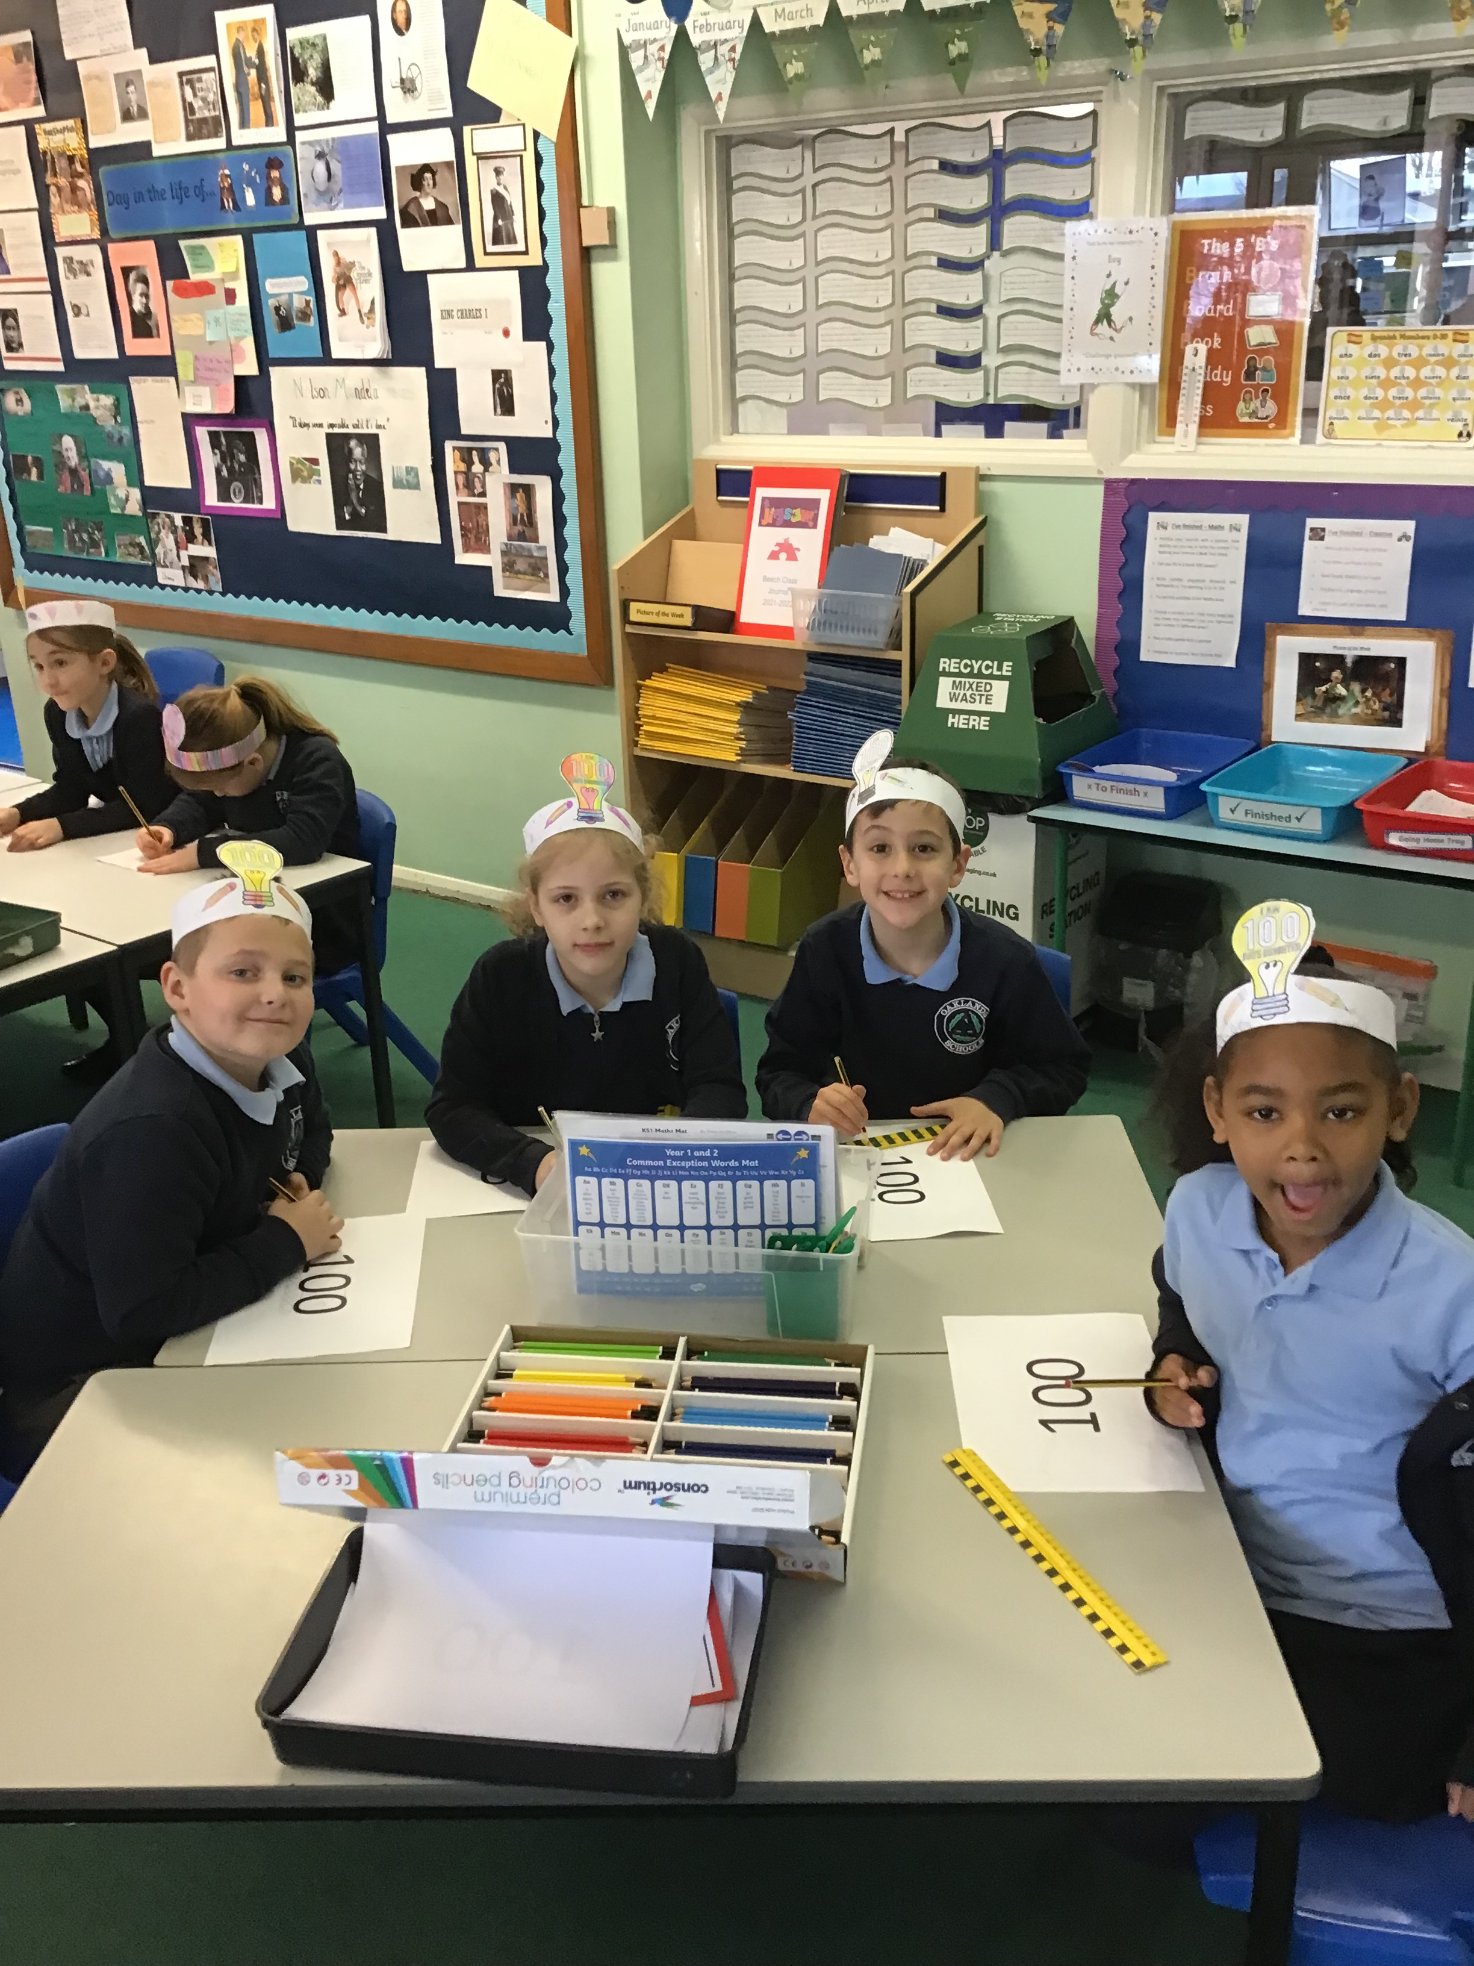
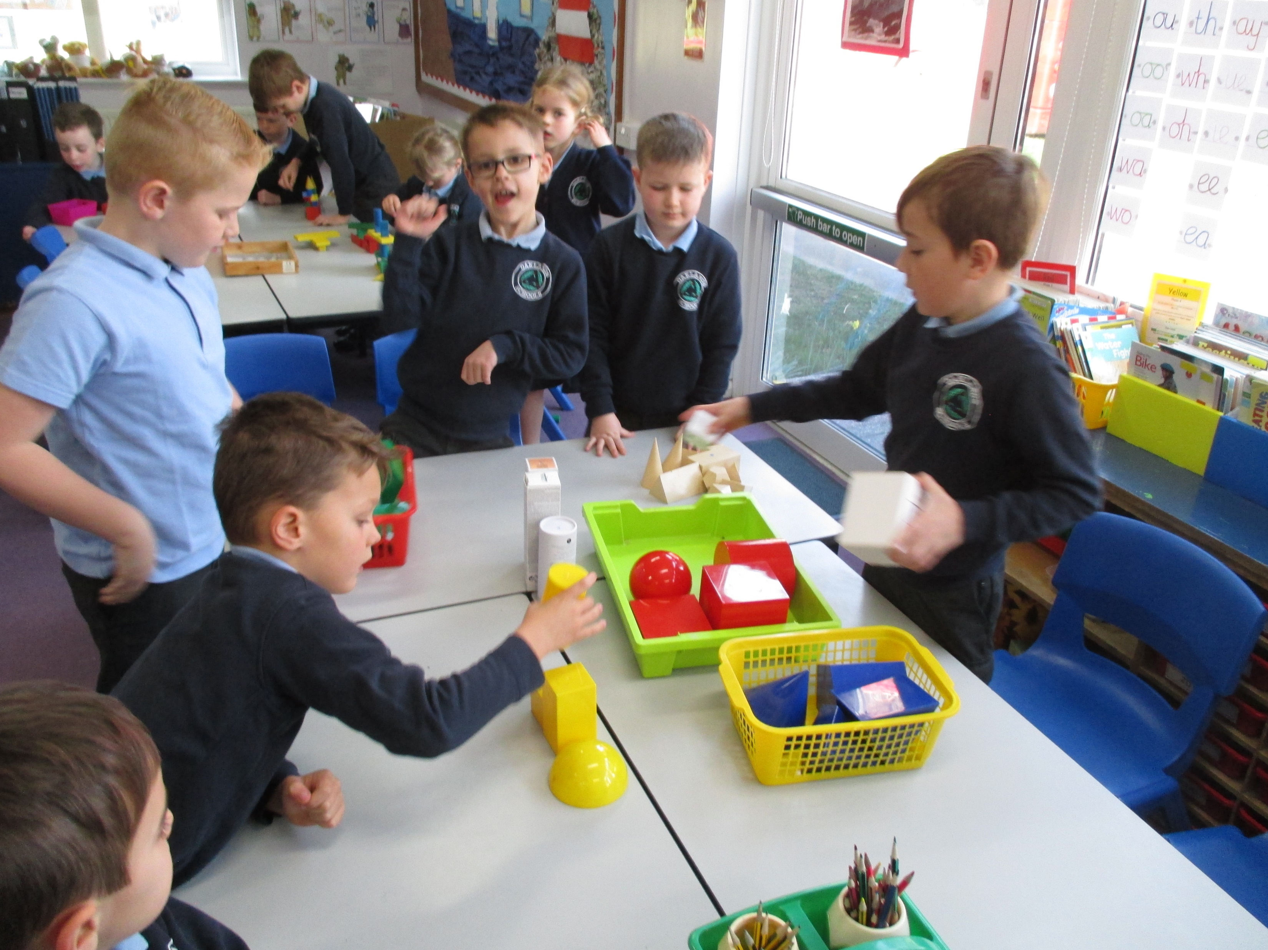
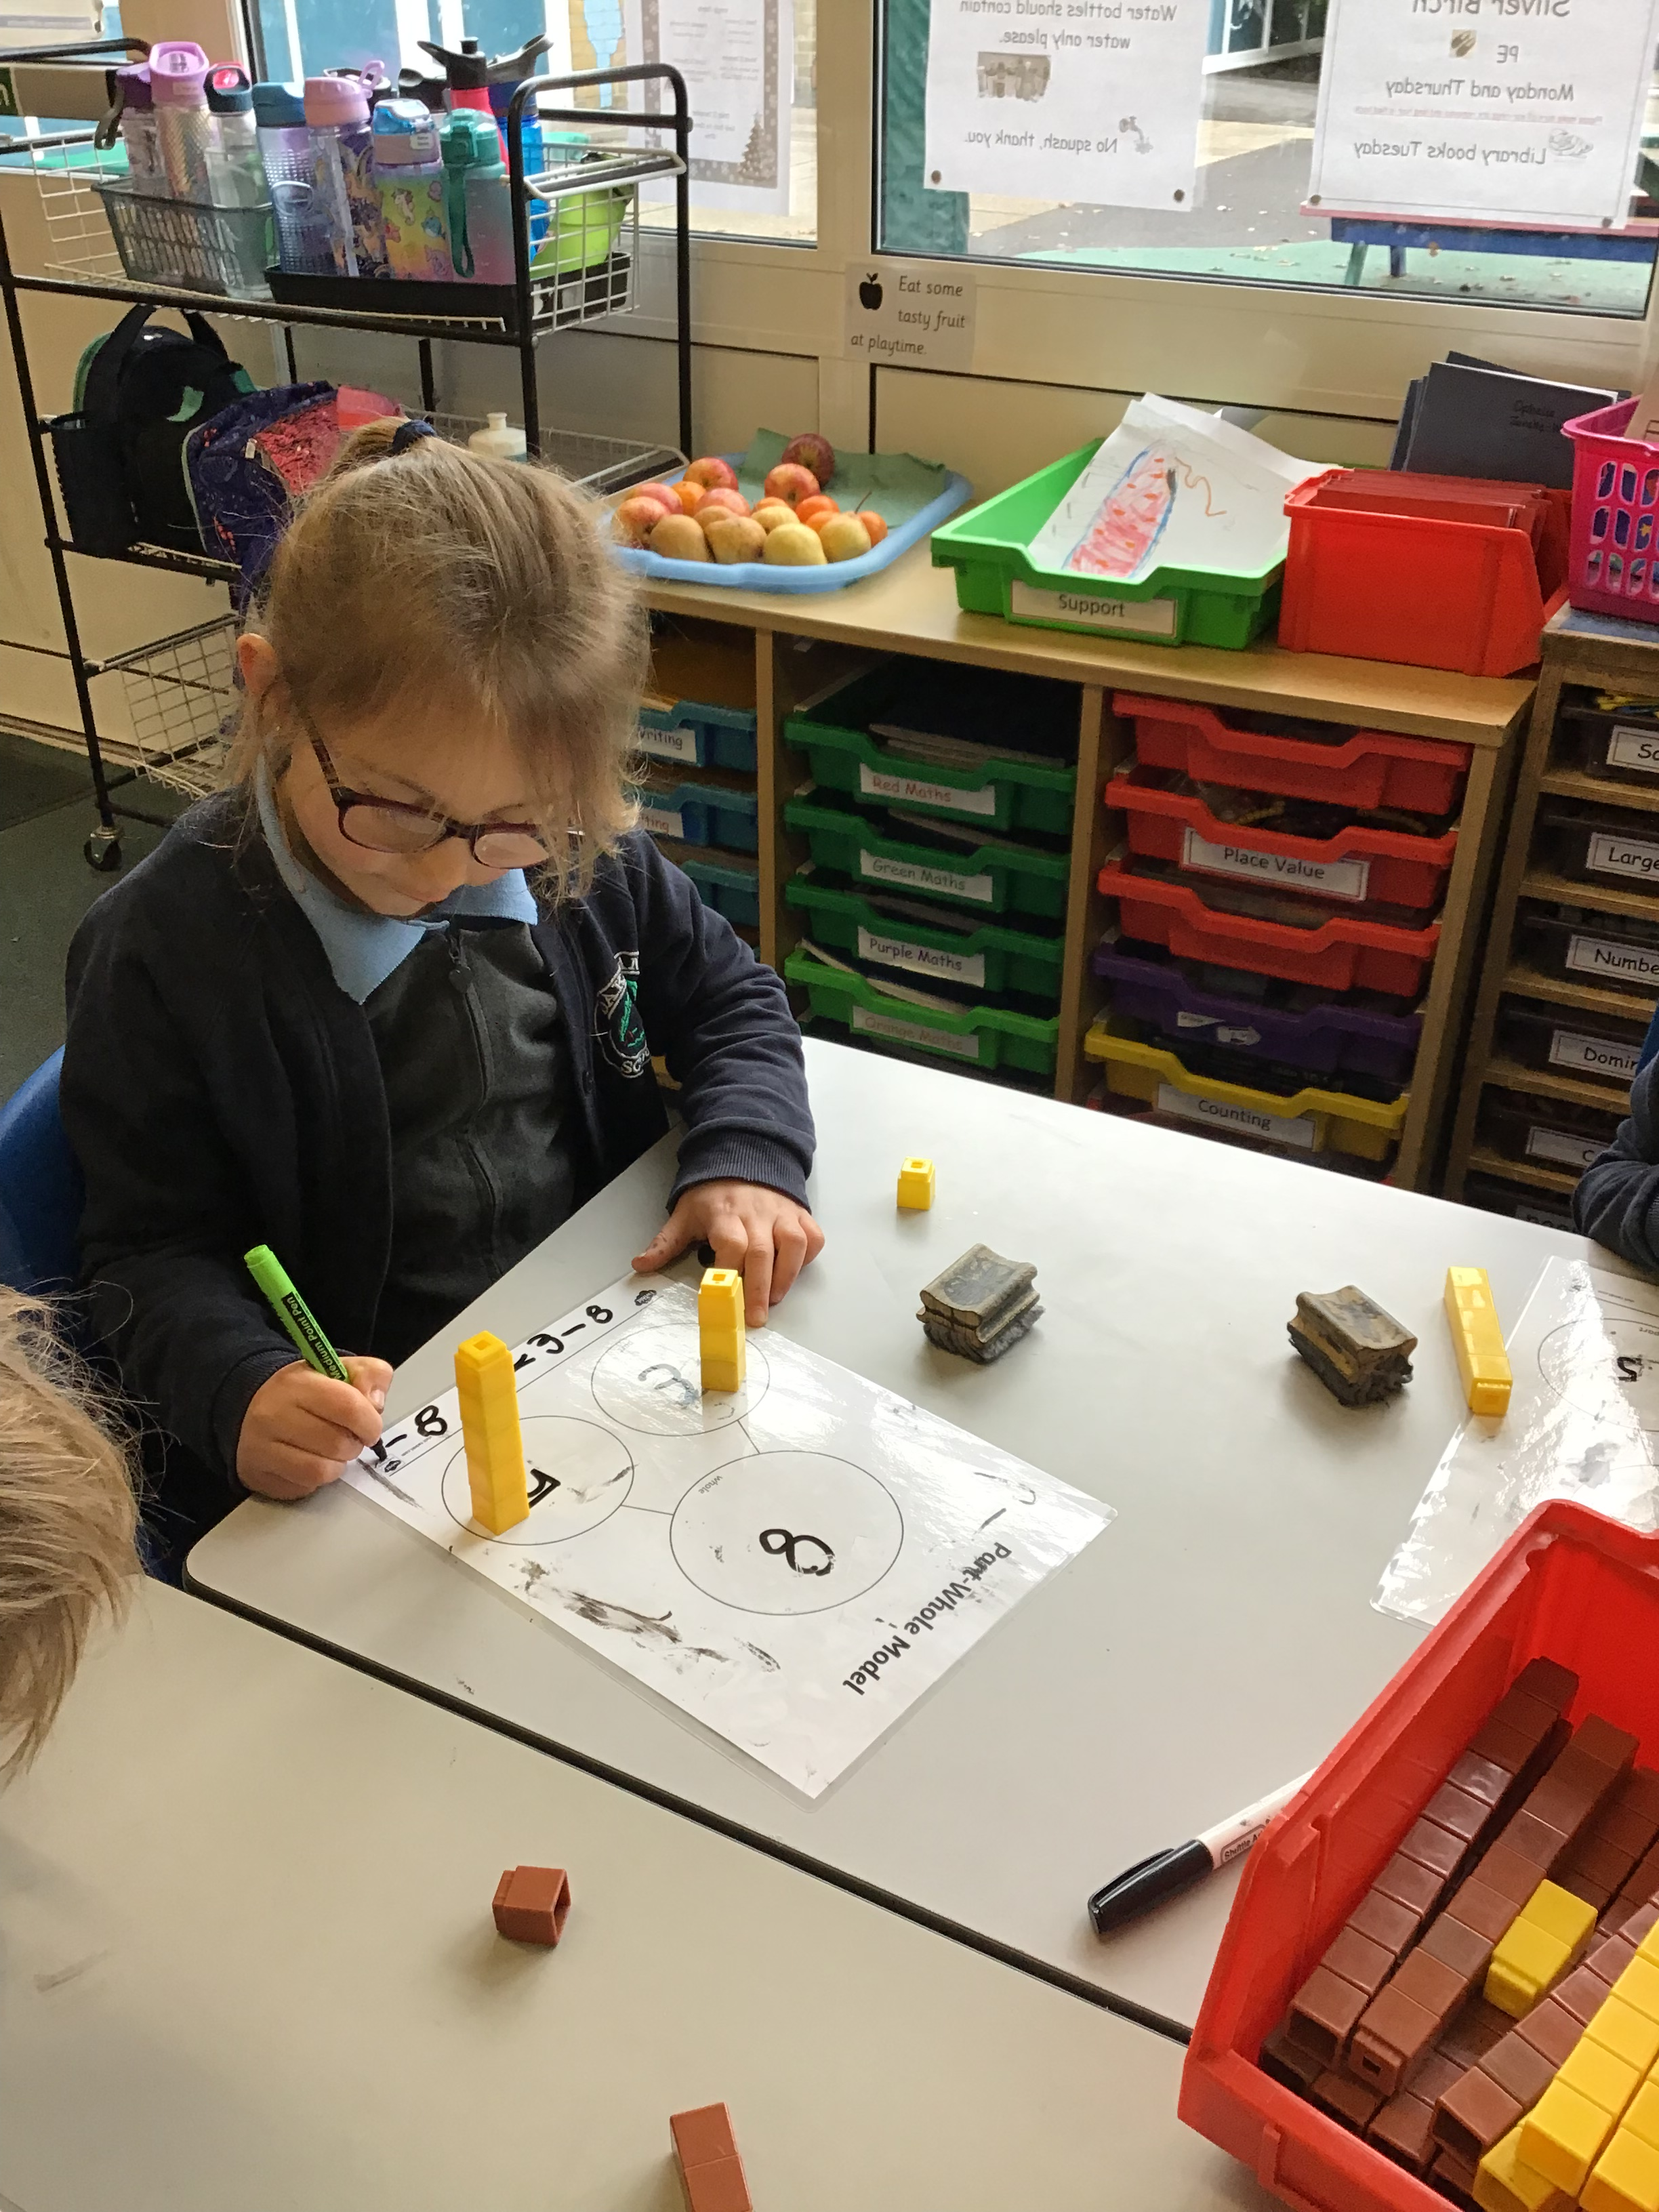
Maths at Oaklands Infants
Parent Workshop March 2022
Miss Davies
Miss Devereaux

Slide 2
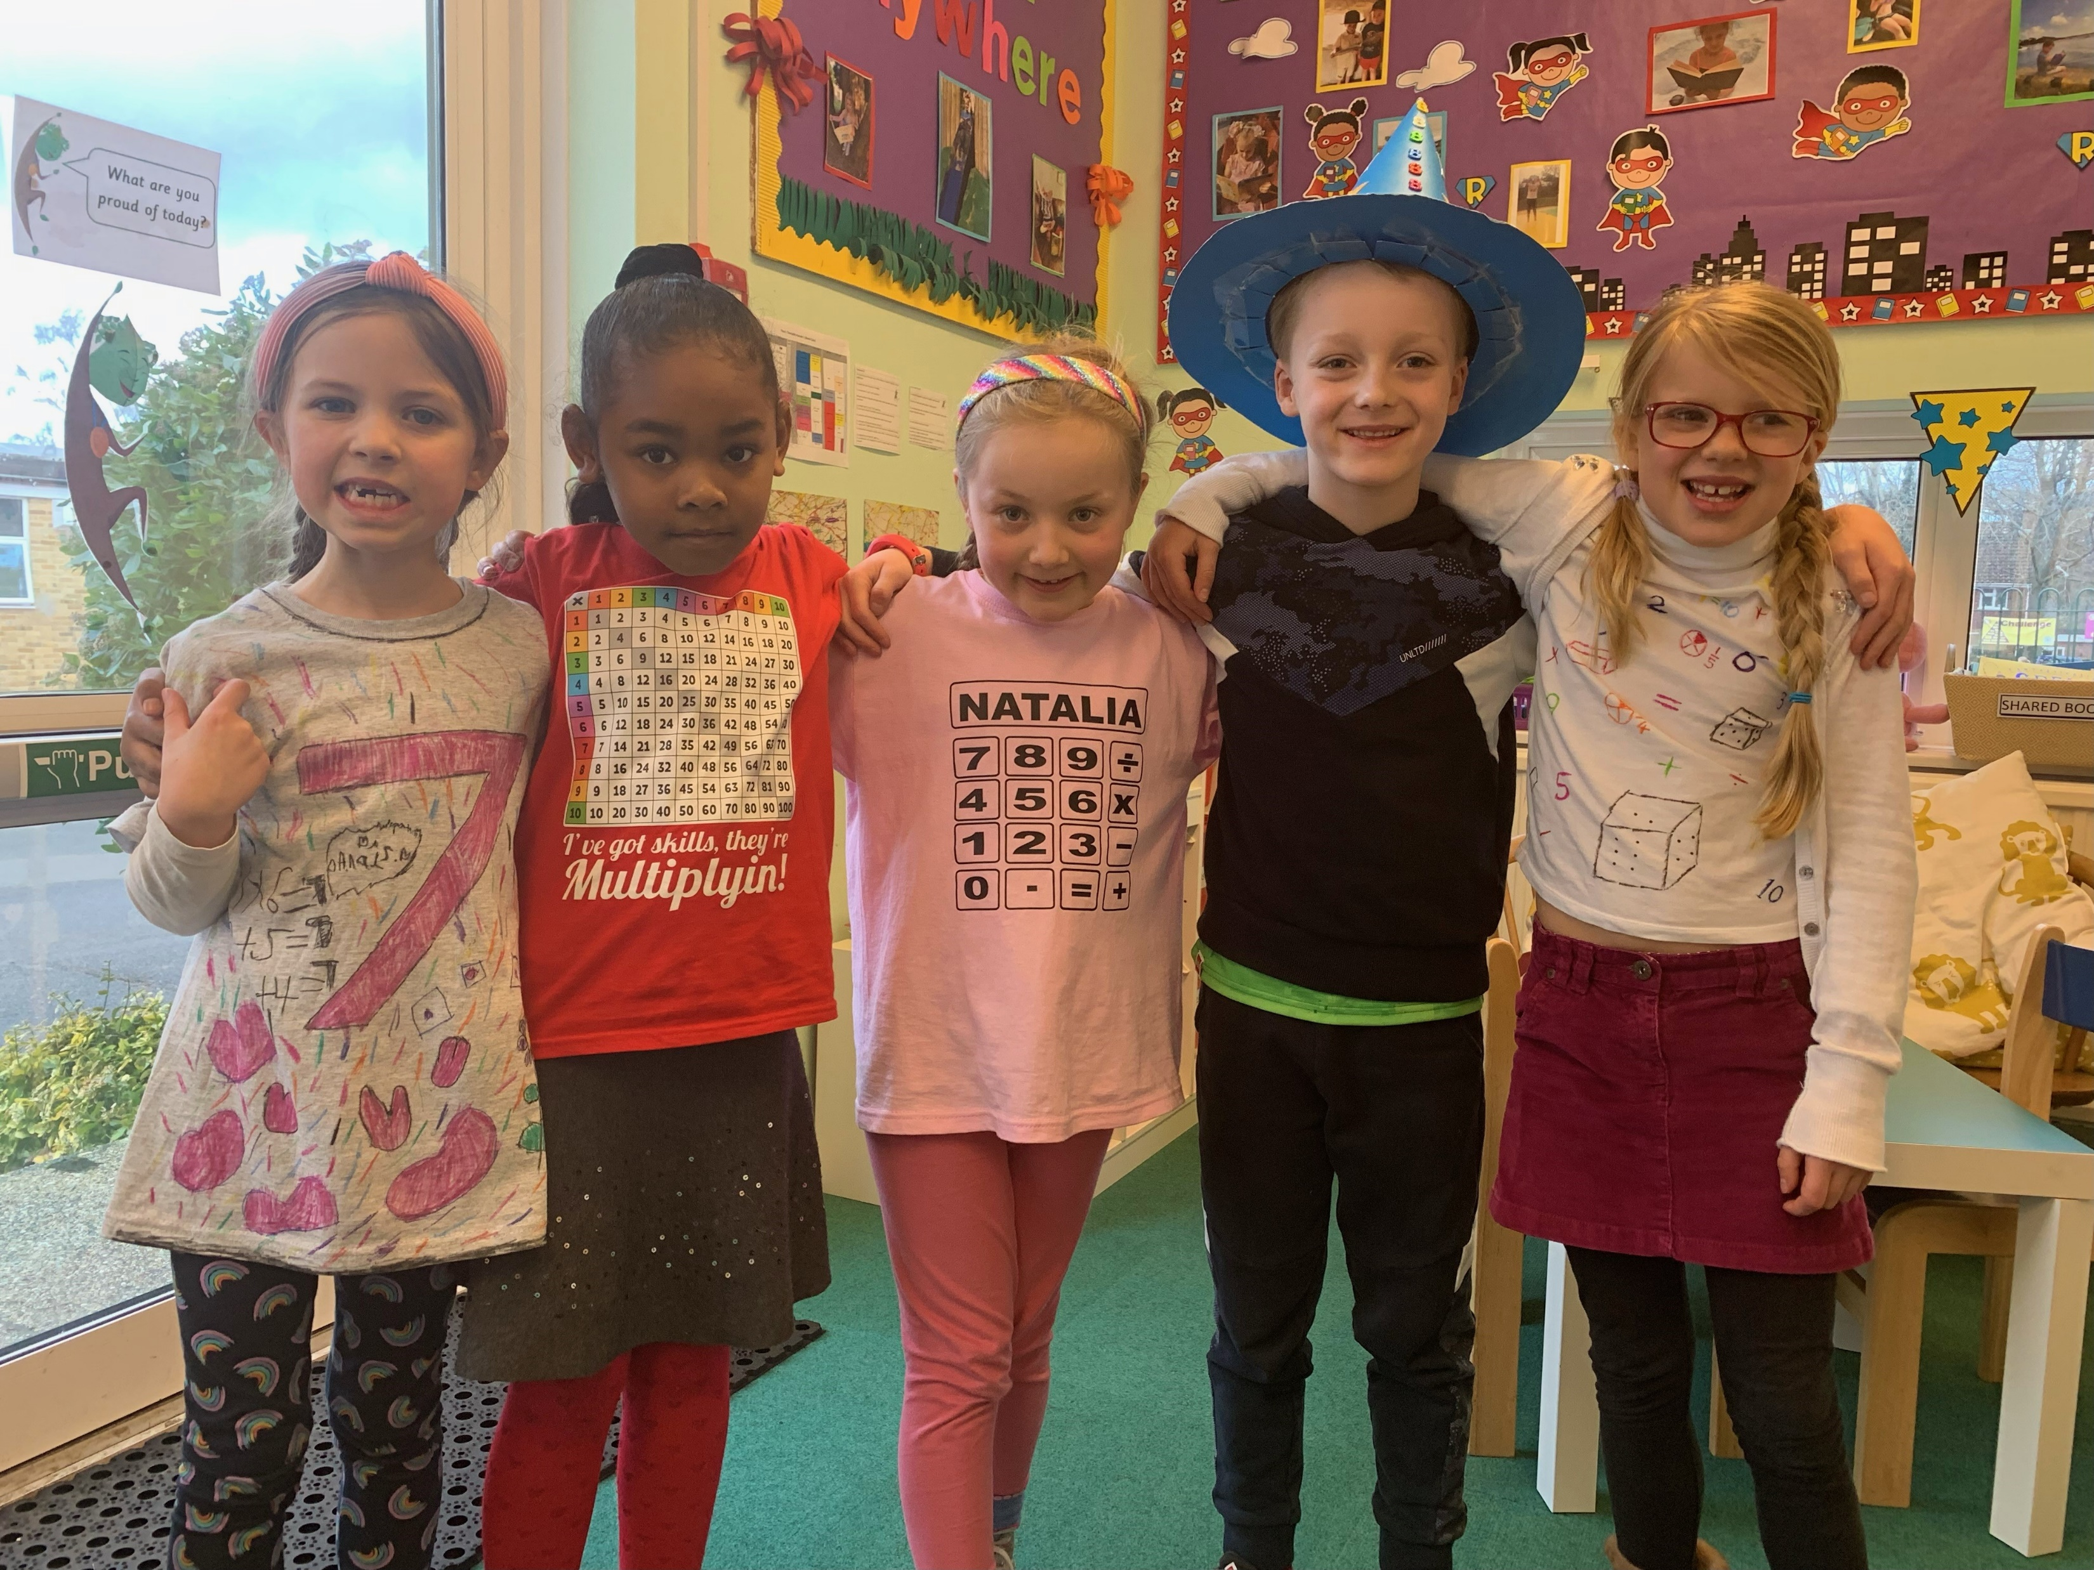
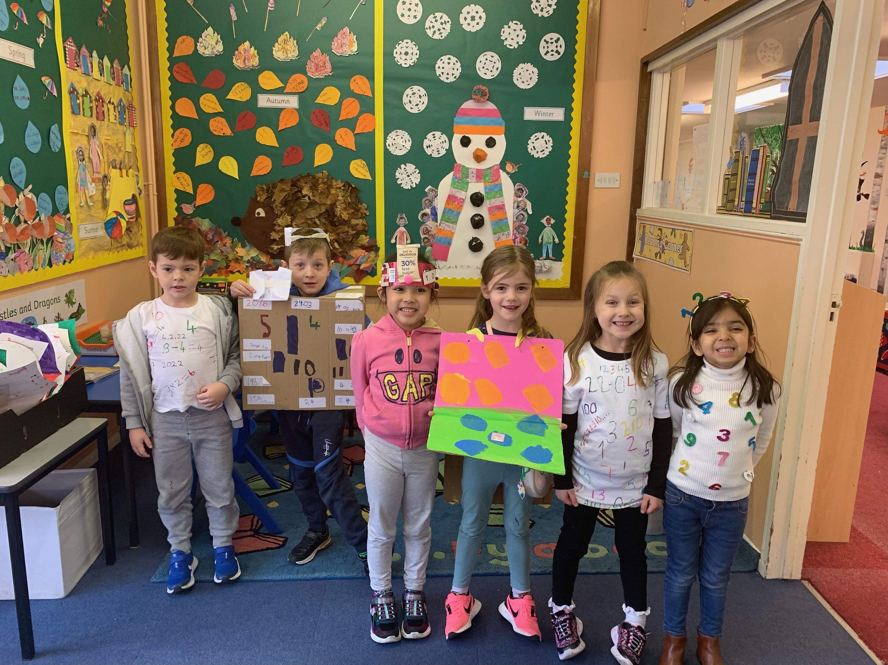
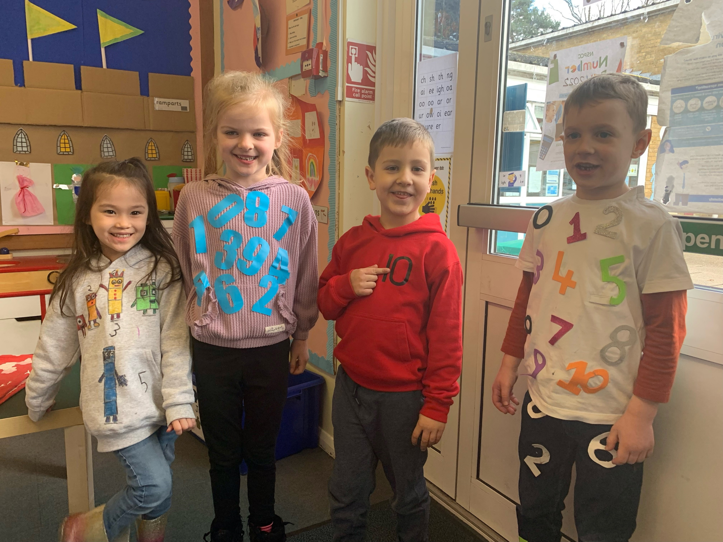
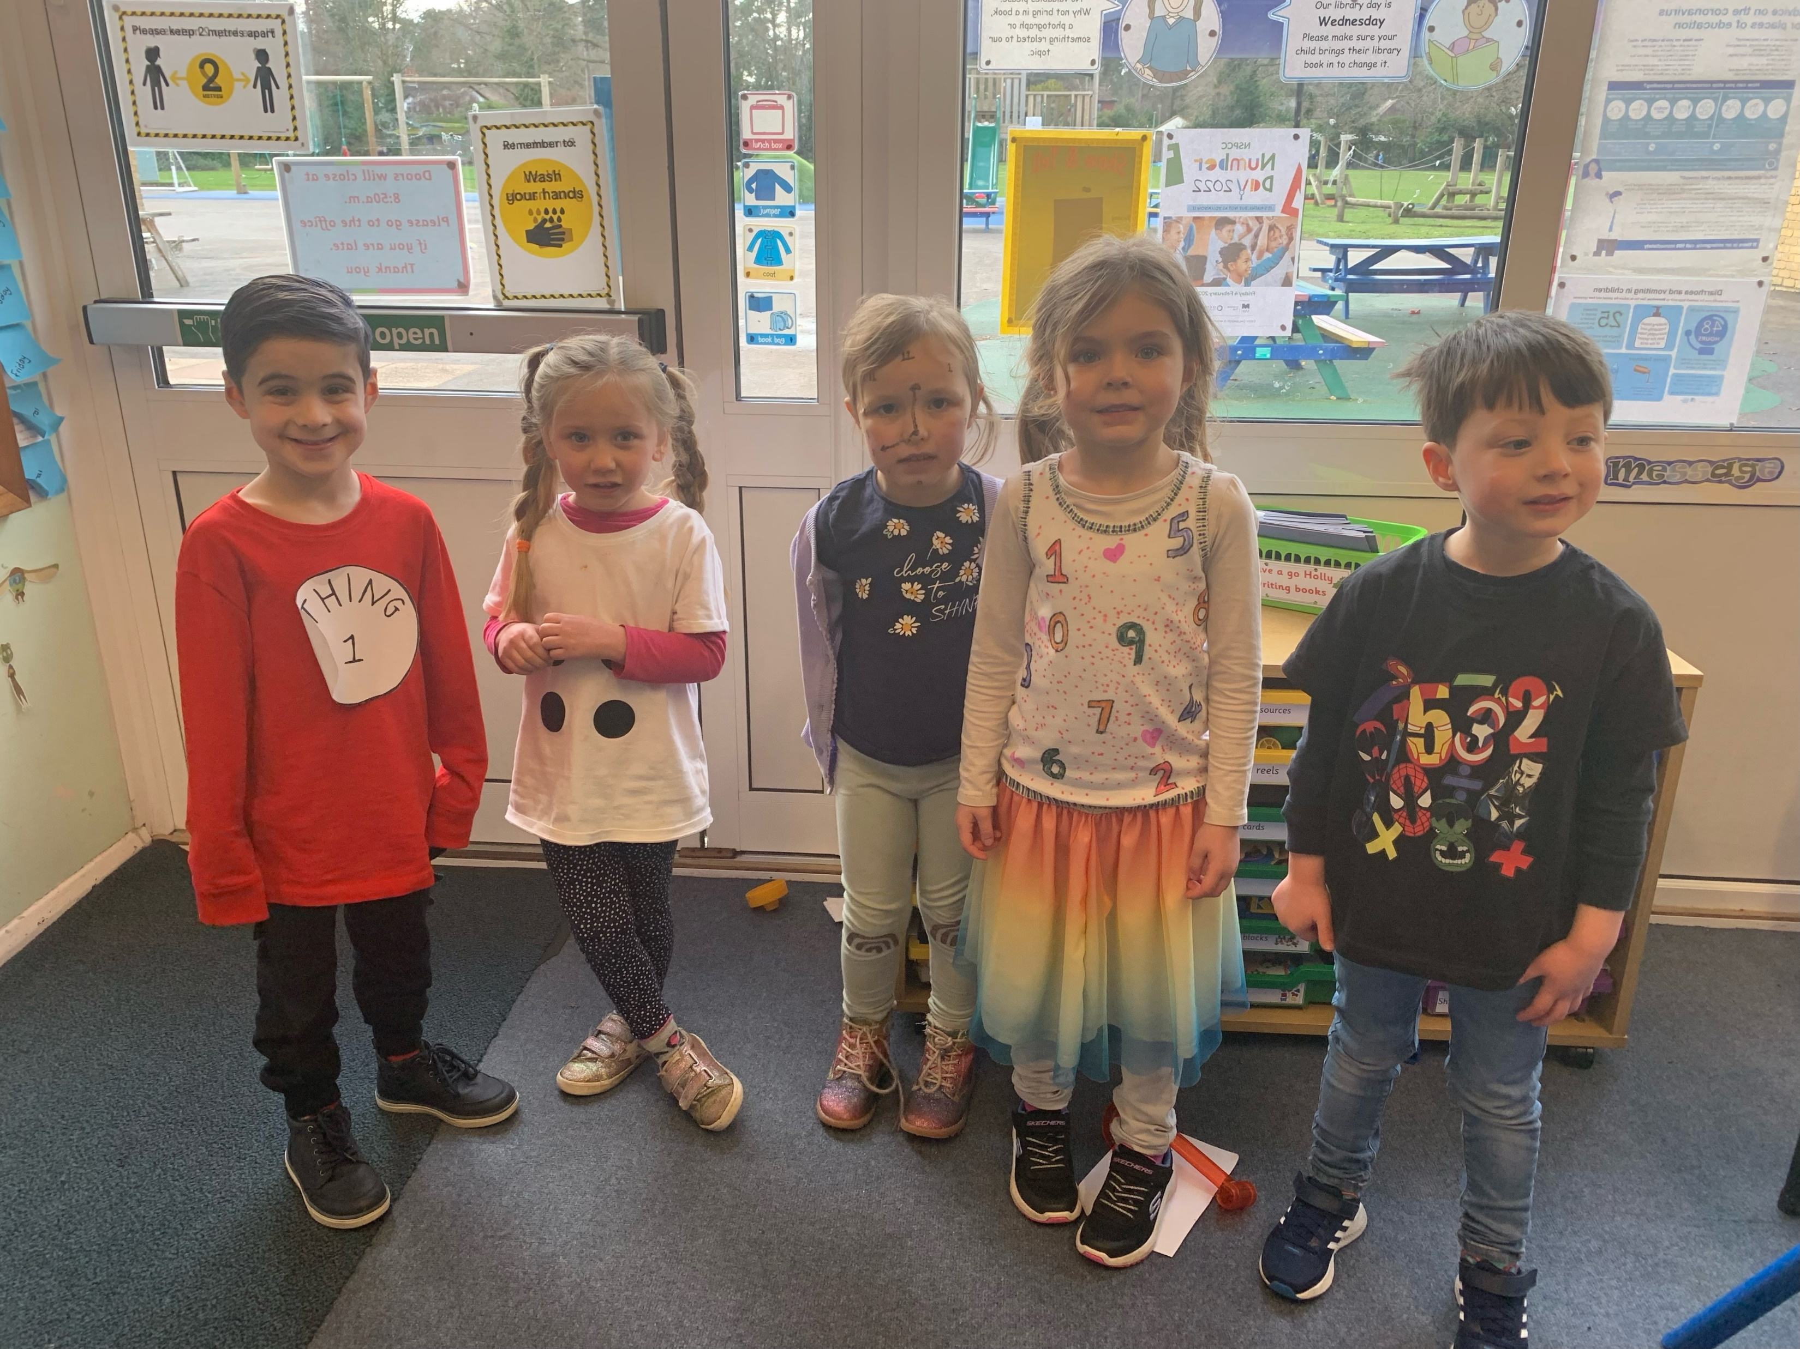
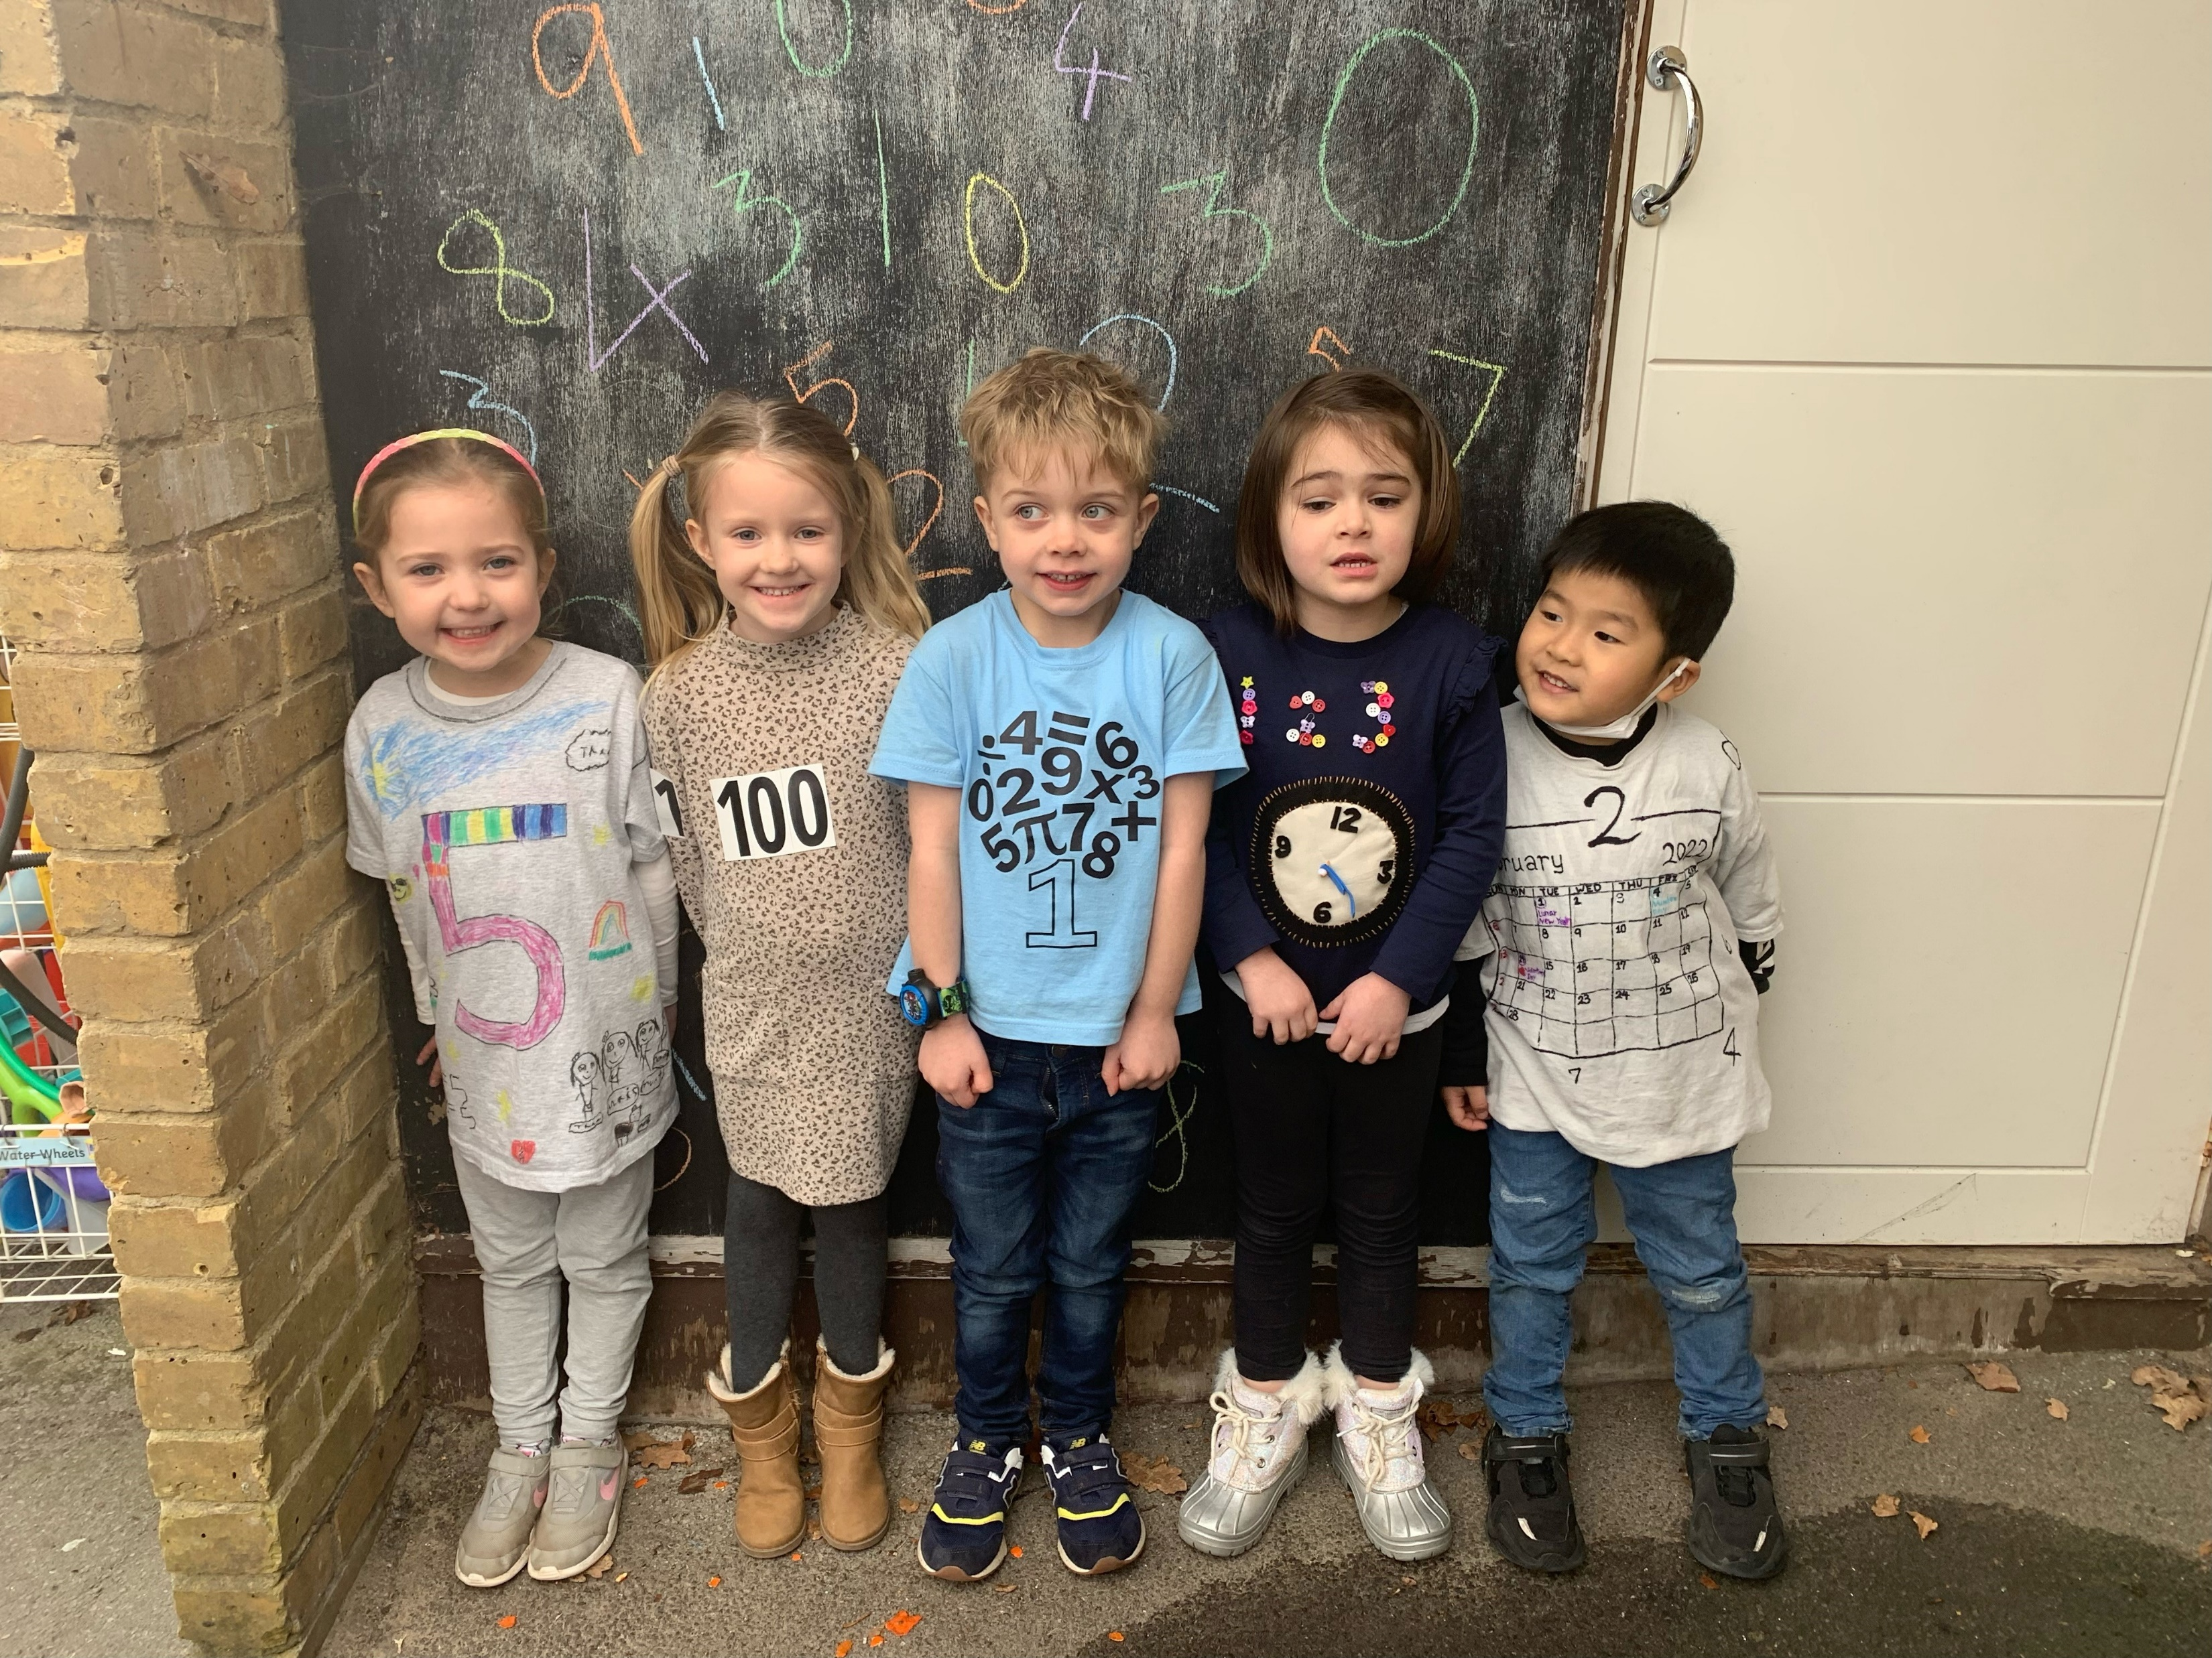
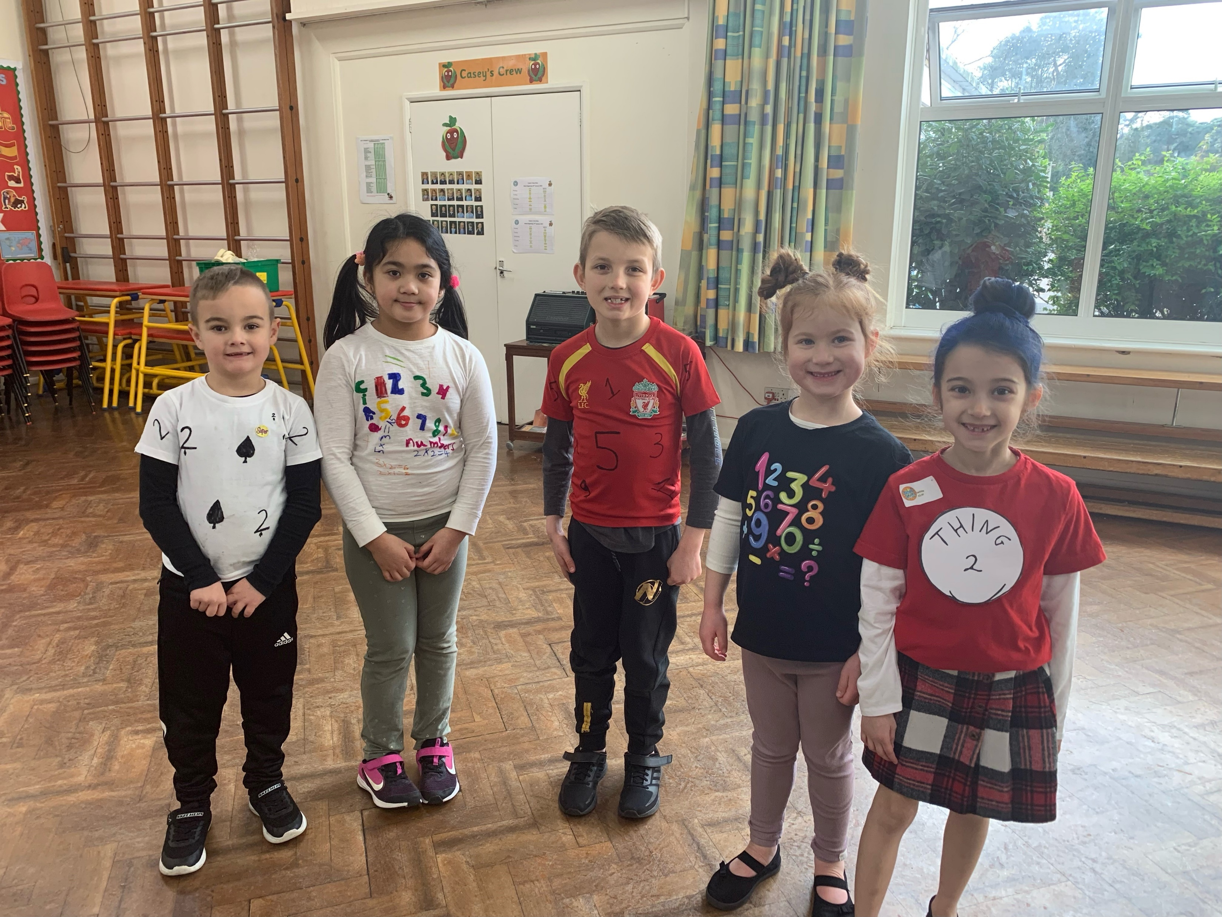
Aims
To get an insight into how Maths is taught at Oaklands Infant School
To take away some ideas to help your child at home

Slide 3
Maths warm up
Ping Pong

Slide 4
Our Intent
We aim to ensure that our Maths curriculum promotes a true love of the subject and pupils will:
become fluent .
reason mathematically
be challenged through solving problems
think like a mathematician
show their thinking
make real life, cross curricular links

Slide 5
What is Maths Mastery?
The Maths Mastery approach focuses on whole class teaching and developing a deep understanding. All pupils are encouraged to believe that through their own efforts they can succeed.
Teaching for Mastery can be summarised with a few key principles:
High expectations for every child
Fewer topics covered in greater depth
Number sense and place value are priorities
Reasoning and problem solving is central to all learning
Challenge is provided through increased depth, rather than acceleration of content.

Slide 6
Put in it’s simplest form
Mastery can be thought of as:
Factual – I know that
Procedural – I know how
Conceptual – I know why

Slide 7
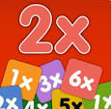
What does a Maths Mastery lesson look like?
A typical Maths mastery lesson is led by the teacher, with all of the pupils in the class working together on the same tasks at the same time. The pace of the class is governed by the children, giving them time to revisit key concepts frequently throughout the lesson.
There’s a mixture of short tasks, explanation, demonstration and discussion – and a lot of practice to help reinforce children’s learning. There is a focus on mathematical vocabulary.
Children are also expected to learn key maths facts like number bonds or times tables (Year 2) by heart to free up working memory and give them the mental space to focus on new concepts.

Slide 8
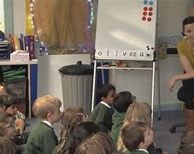
A Year 1 lesson on difference as a form of subtraction | NCETM

Slide 10
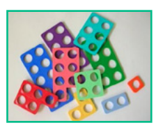
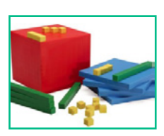
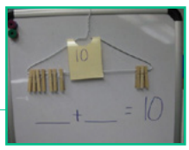
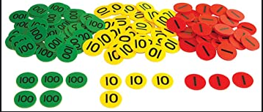
Maths Manipulatives - Concrete
These allow pupils who are learning new ideas to create a visual image and help embed their understanding. Here are some of the resources that are useful to use:
Dienes
Great for developing an understanding of place value. Also for exploring the idea of regrouping in addition and subtraction
Numicon
Great for developing number sense and relationships.
Wooden or plastic clothes are good for looking at number bonds.
Place Value counters

Slide 11
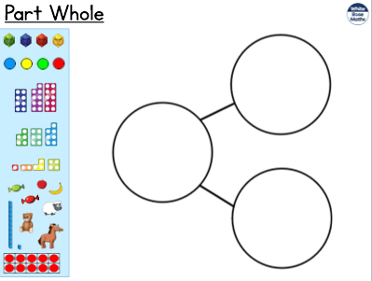
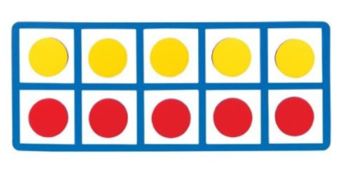
Part Whole Model
Pictorial
Bar Models
5 and 10 frames

Slide 12
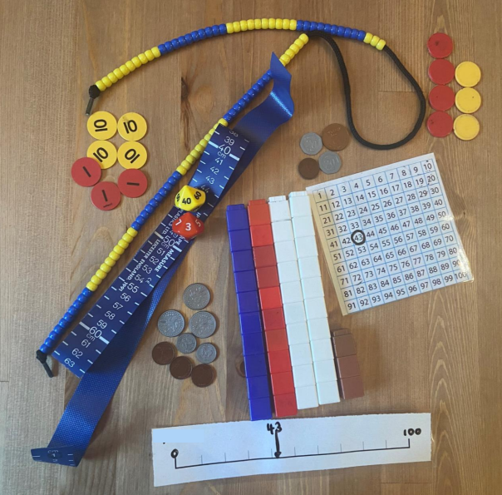
Number Smash
Make 43

Slide 13
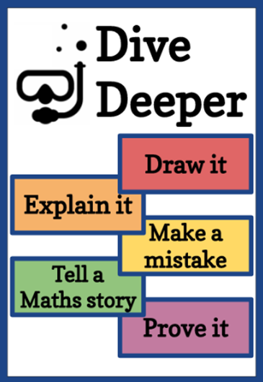
How is every child supported and challenged?
explain
think
communication
prove
justify
ask
.
explore
connect
Mathematical language

Slide 14
Two children are discussing how some objects have been sorted.
Dora
Jack
Who is correct? Convince me.
These objects have been sorted into cubes and counters.
These objects have been sorted into green and yellow.

Slide 15
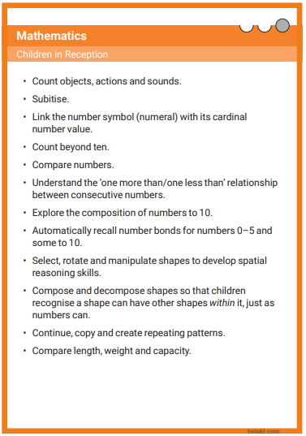
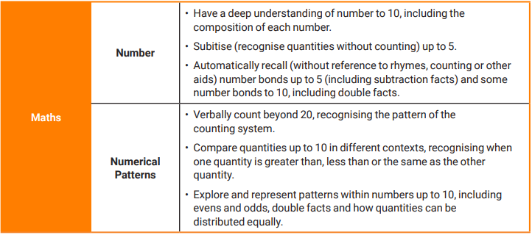
Reception key expectations

Slide 16
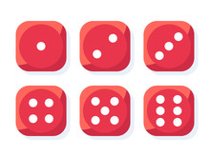
Subitising
Subitising is the ability to instantly recognise the number of objects in a small group without the need to count them. For example, when a student rolls a dice they can instantly recognise the number of dots on the face of the dice.

Slide 25
Subitising
Which were easy? Which were more difficult?
Subitizing comes in two forms: perceptual subitising and conceptual subitizing.
Perceptual subitising is the simplest, and even animals are able to do it.
It is the instant visual recognition of a pattern such as the dots on a die.
Conceptual subitising is the ability to recognise a whole quantity as the result of recognising smaller quantities.

Slide 27
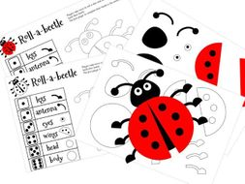
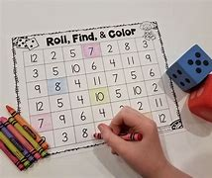
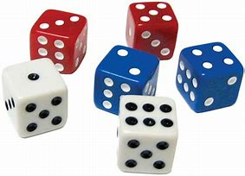
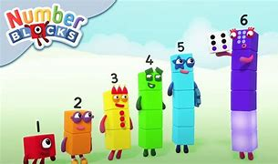
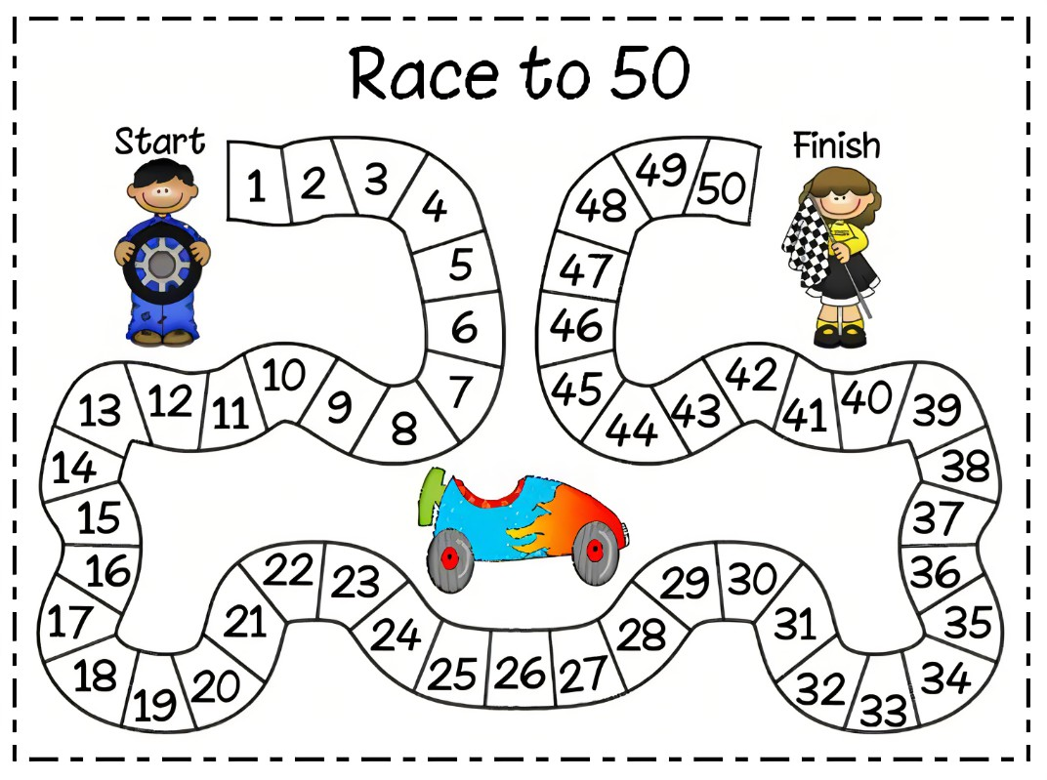
Learning through play
Make it fun

Slide 28
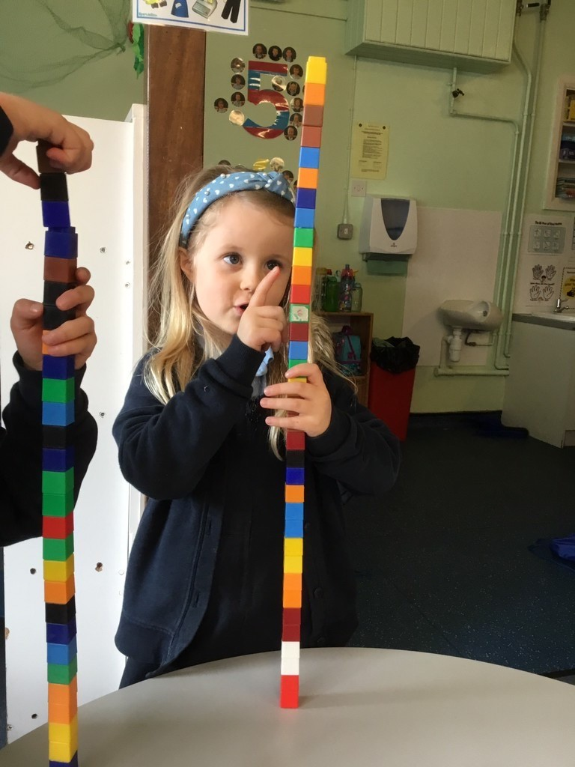
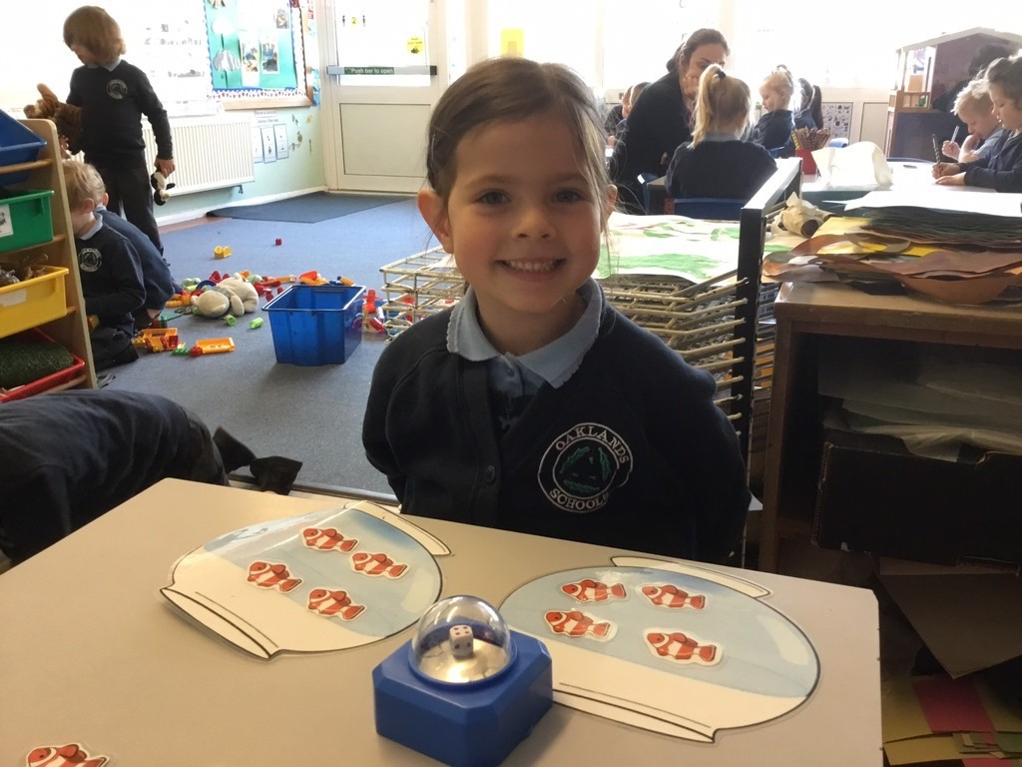
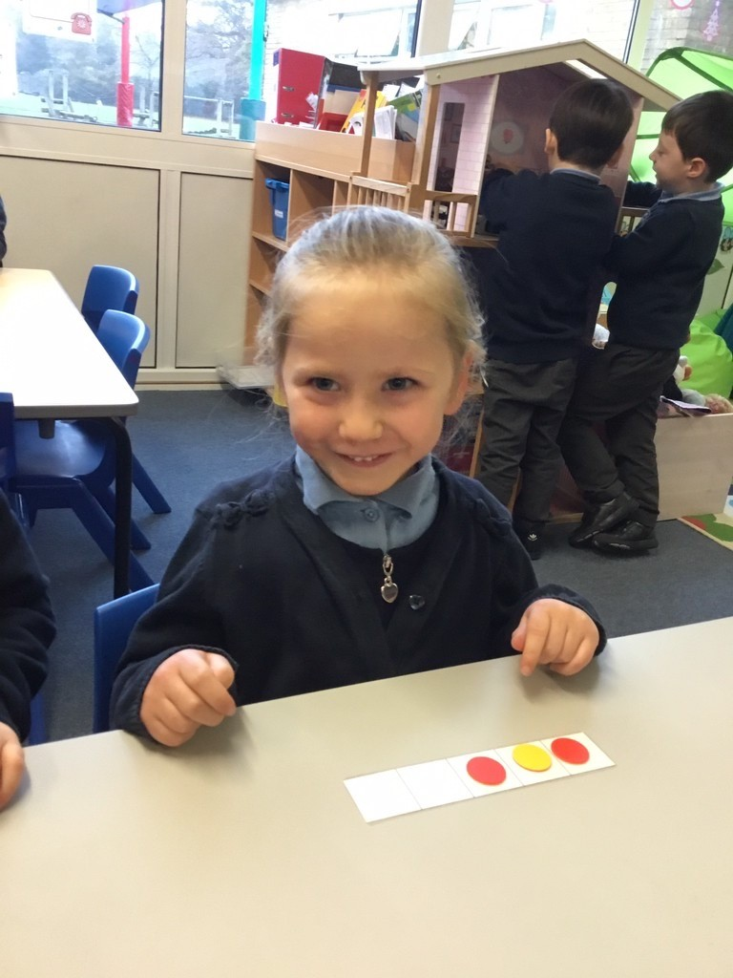
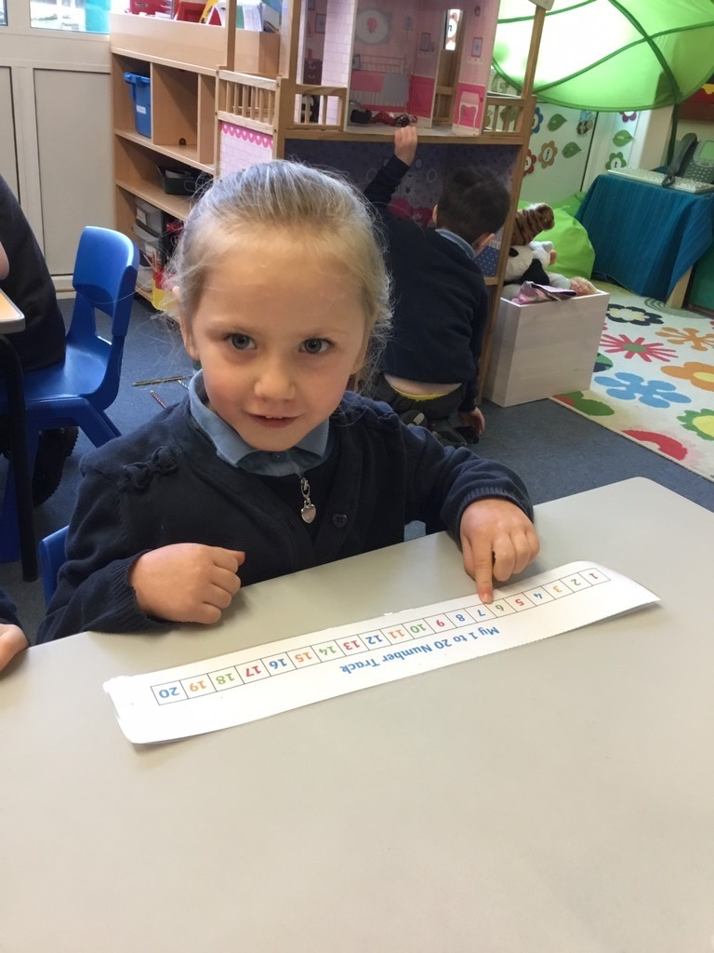
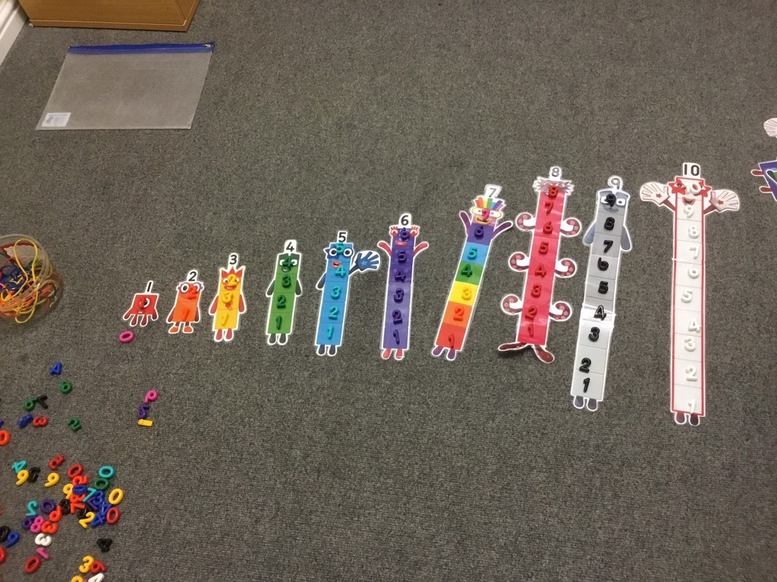

Slide 29
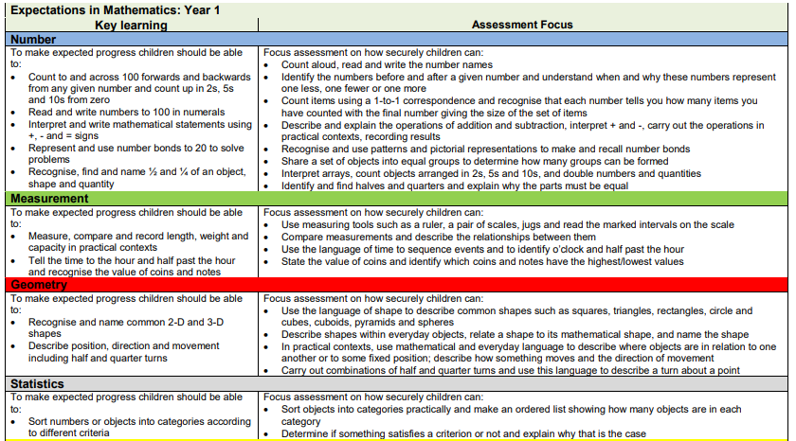
Year 1 key expectations

Slide 30
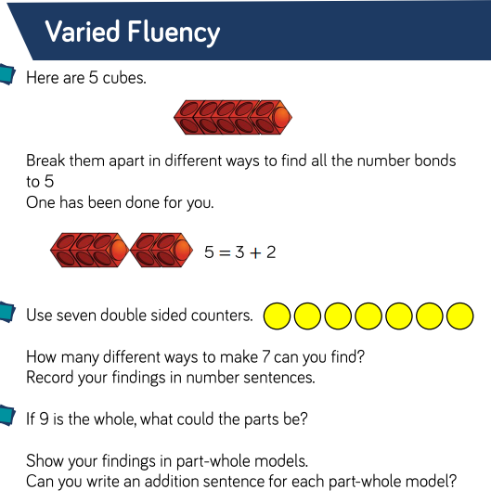
Example of Year One Fluency relating to addition

Slide 31
Examples of reasoning and problem solving for Year One, related to addition.

Slide 32
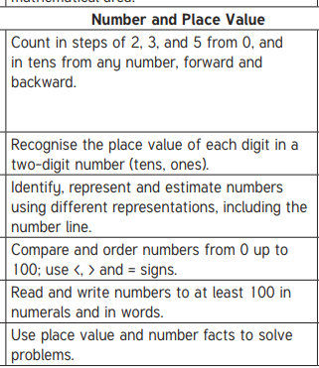
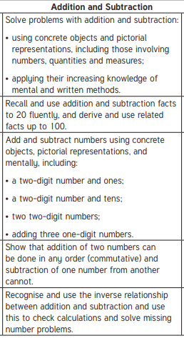
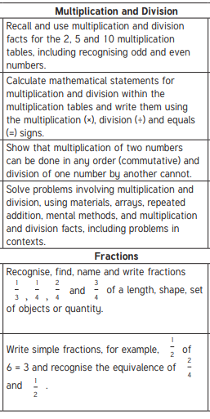
Year 2 key expectations

Slide 33
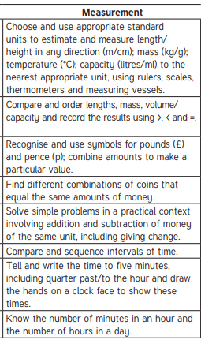
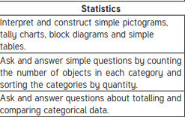
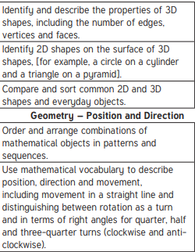

Slide 34
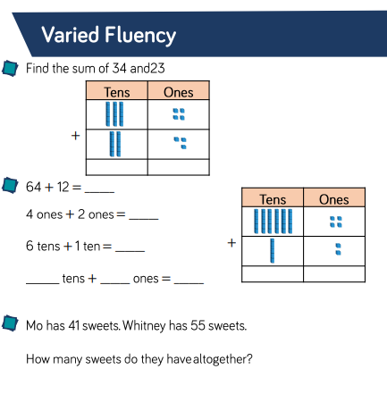
Example of Year Two Fluency relating to addition

Slide 35
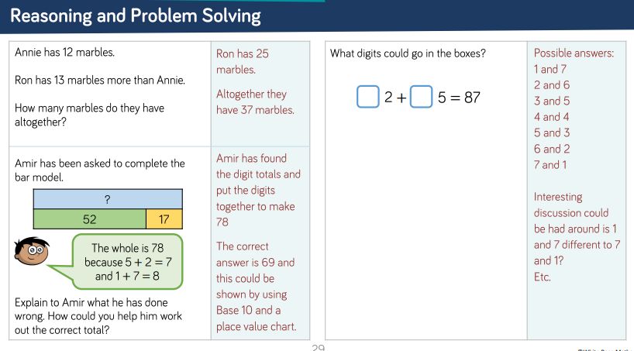
Examples of reasoning and problem solving for Year Two, related to addition.

Slide 36
What can you do at home?

Slide 37
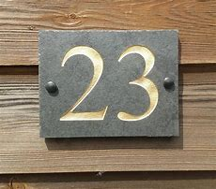
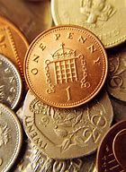
Maths is Everywhere!
Be positive about Maths
Count EVERYTHING - cars going past a window, steps up the stairs
Ask children to say how many without counting (more than/less than 5) – dominoes, dice, ladybirds
Spot numbers/digits in the environment – on phones, buses, oven, clocks, vehicle number plates, doors, bills
Deliberately make mistakes. Children need to understand mistakes are normal and everyone makes them.

Slide 38
Tips for counting: When counting, children need to understand…
That we need to say one number for each object counted (one-to-one correspondence).
That the final number we say is how many objects there are altogether. Some children continue to count after they have reached the final object as they don’t connect the numbers they are saying to the objects in front of them.
That we can count objects in any order and the total stays the same. (but random counting is not efficient)

Slide 39
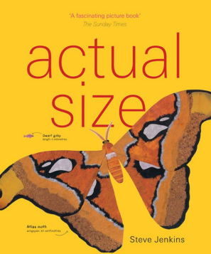
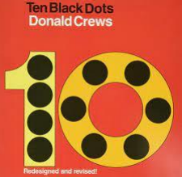
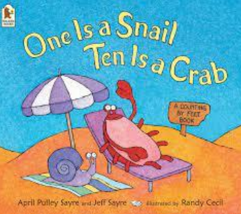
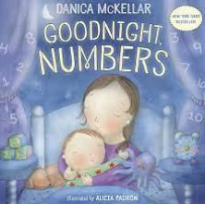
Read books with maths concepts - The Very Hungry Caterpillar, One is a snail, ten is a crab, Ten Little Pirates, Baby ,Goes To Market, What’s the time, Mr Wolf?

Slide 40
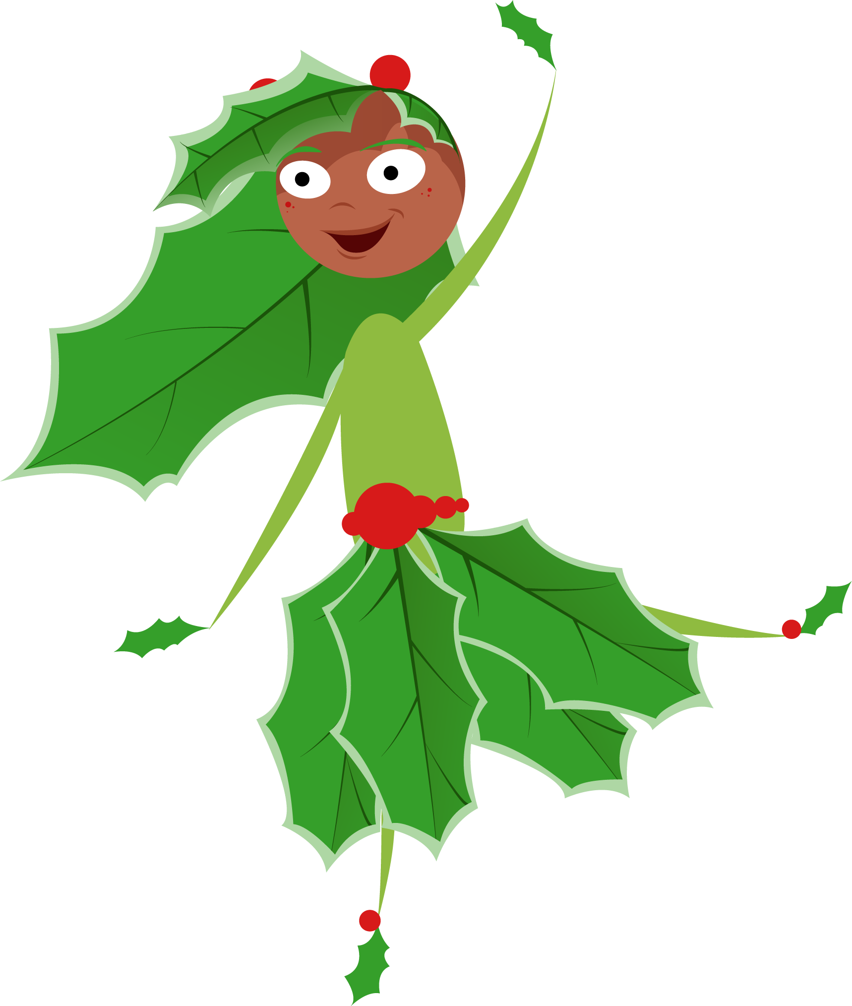
Remember have fun and everyone is a mathematician!

