Slide 1



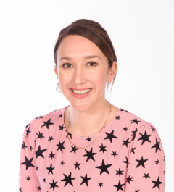
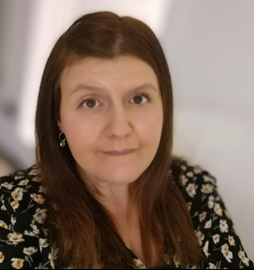
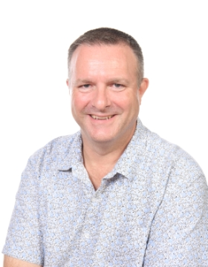
Welcome to Beech class
Miss Stone
Class TA
Miss Davies
Class Teacher
Mr Gunn
Class Teacher

Slide 2
Welcome to Beech class
 | Mon | Tue | Wed | Thu | Fri
Week 1 | Mr Gunn | Mr Gunn | Mr Gunn | Miss Davies | Miss Davies
Week 2 | Mr Gunn | Mr Gunn | Miss Davies | Miss Davies | Mr Gunn

Slide 3
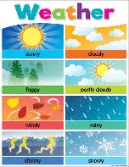

What your child needs every day
Their book bag - 1 small flat key ring only
A coat to match the weather
Reading books and reading records every day
Water bottle – only water please
Long hair to be tied back every day - hair bands to match school colours.
PE kit - including tracksuit bottoms for cold weather and plimsolls/trainers (that they can do up)
Earrings to be removed on PE day please: Wednesday and Friday

Slide 4

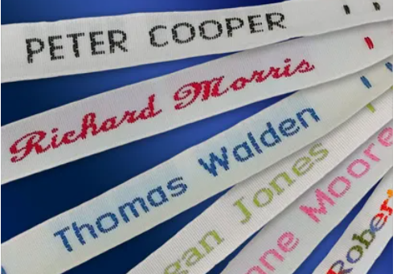
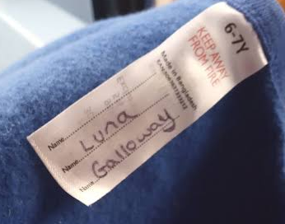
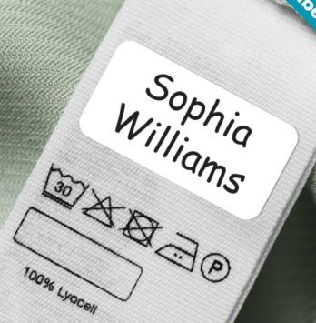
  Labels on EVERYTHING please – bottles, all PE kit items, shoes, bags, jumpers, coats, gloves, hats, etc.

Slide 5

Library
Our library days are Fridays.
Children can choose one book per week for you to enjoy together at home.
Please ensure your child keeps their library books safe and returns them the following week in order to take home new books.

Slide 6
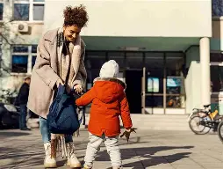
  Change of pick up arrangements
  Please email the school office if pick up arrangements change or your child has a hospital appointment.
  Alternatively send a note in with your child (in their hand, not their bag).

Slide 7
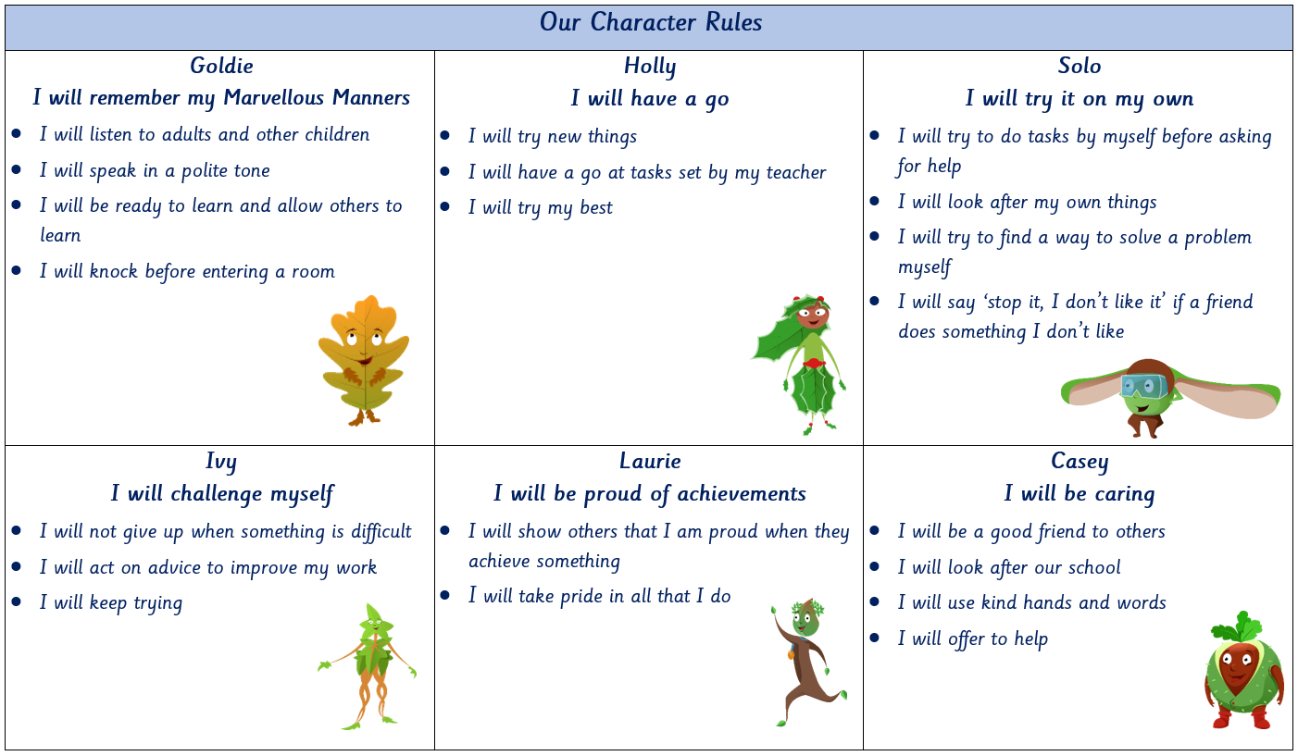
Each term we will focus on a different character.

Slide 8


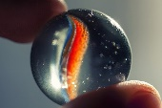

Positive Reinforcement
    Every Monday, two children from each class, who have shown behaviour linked with the current ‘focus’ character, will be awarded a ‘leaf’ during assembly and will have ‘tea’ with one of the SLT later in the week.
    Each week a child will be chosen at random to be star of the week. During that week any of the children can write or draw something positive about the ‘Star of the Week’.
    The children can individually or as a class earn marbles for making positive choices in their learning and behaviours. Once the marble jar is full the class vote for their reward e.g. bring a teddy to school, extra playtime etc.
    Each week, one class wins the Class of the Week trophy.

Slide 9

Oaklands Way chart

Slide 10
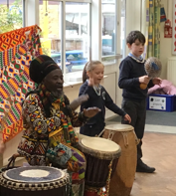
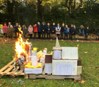
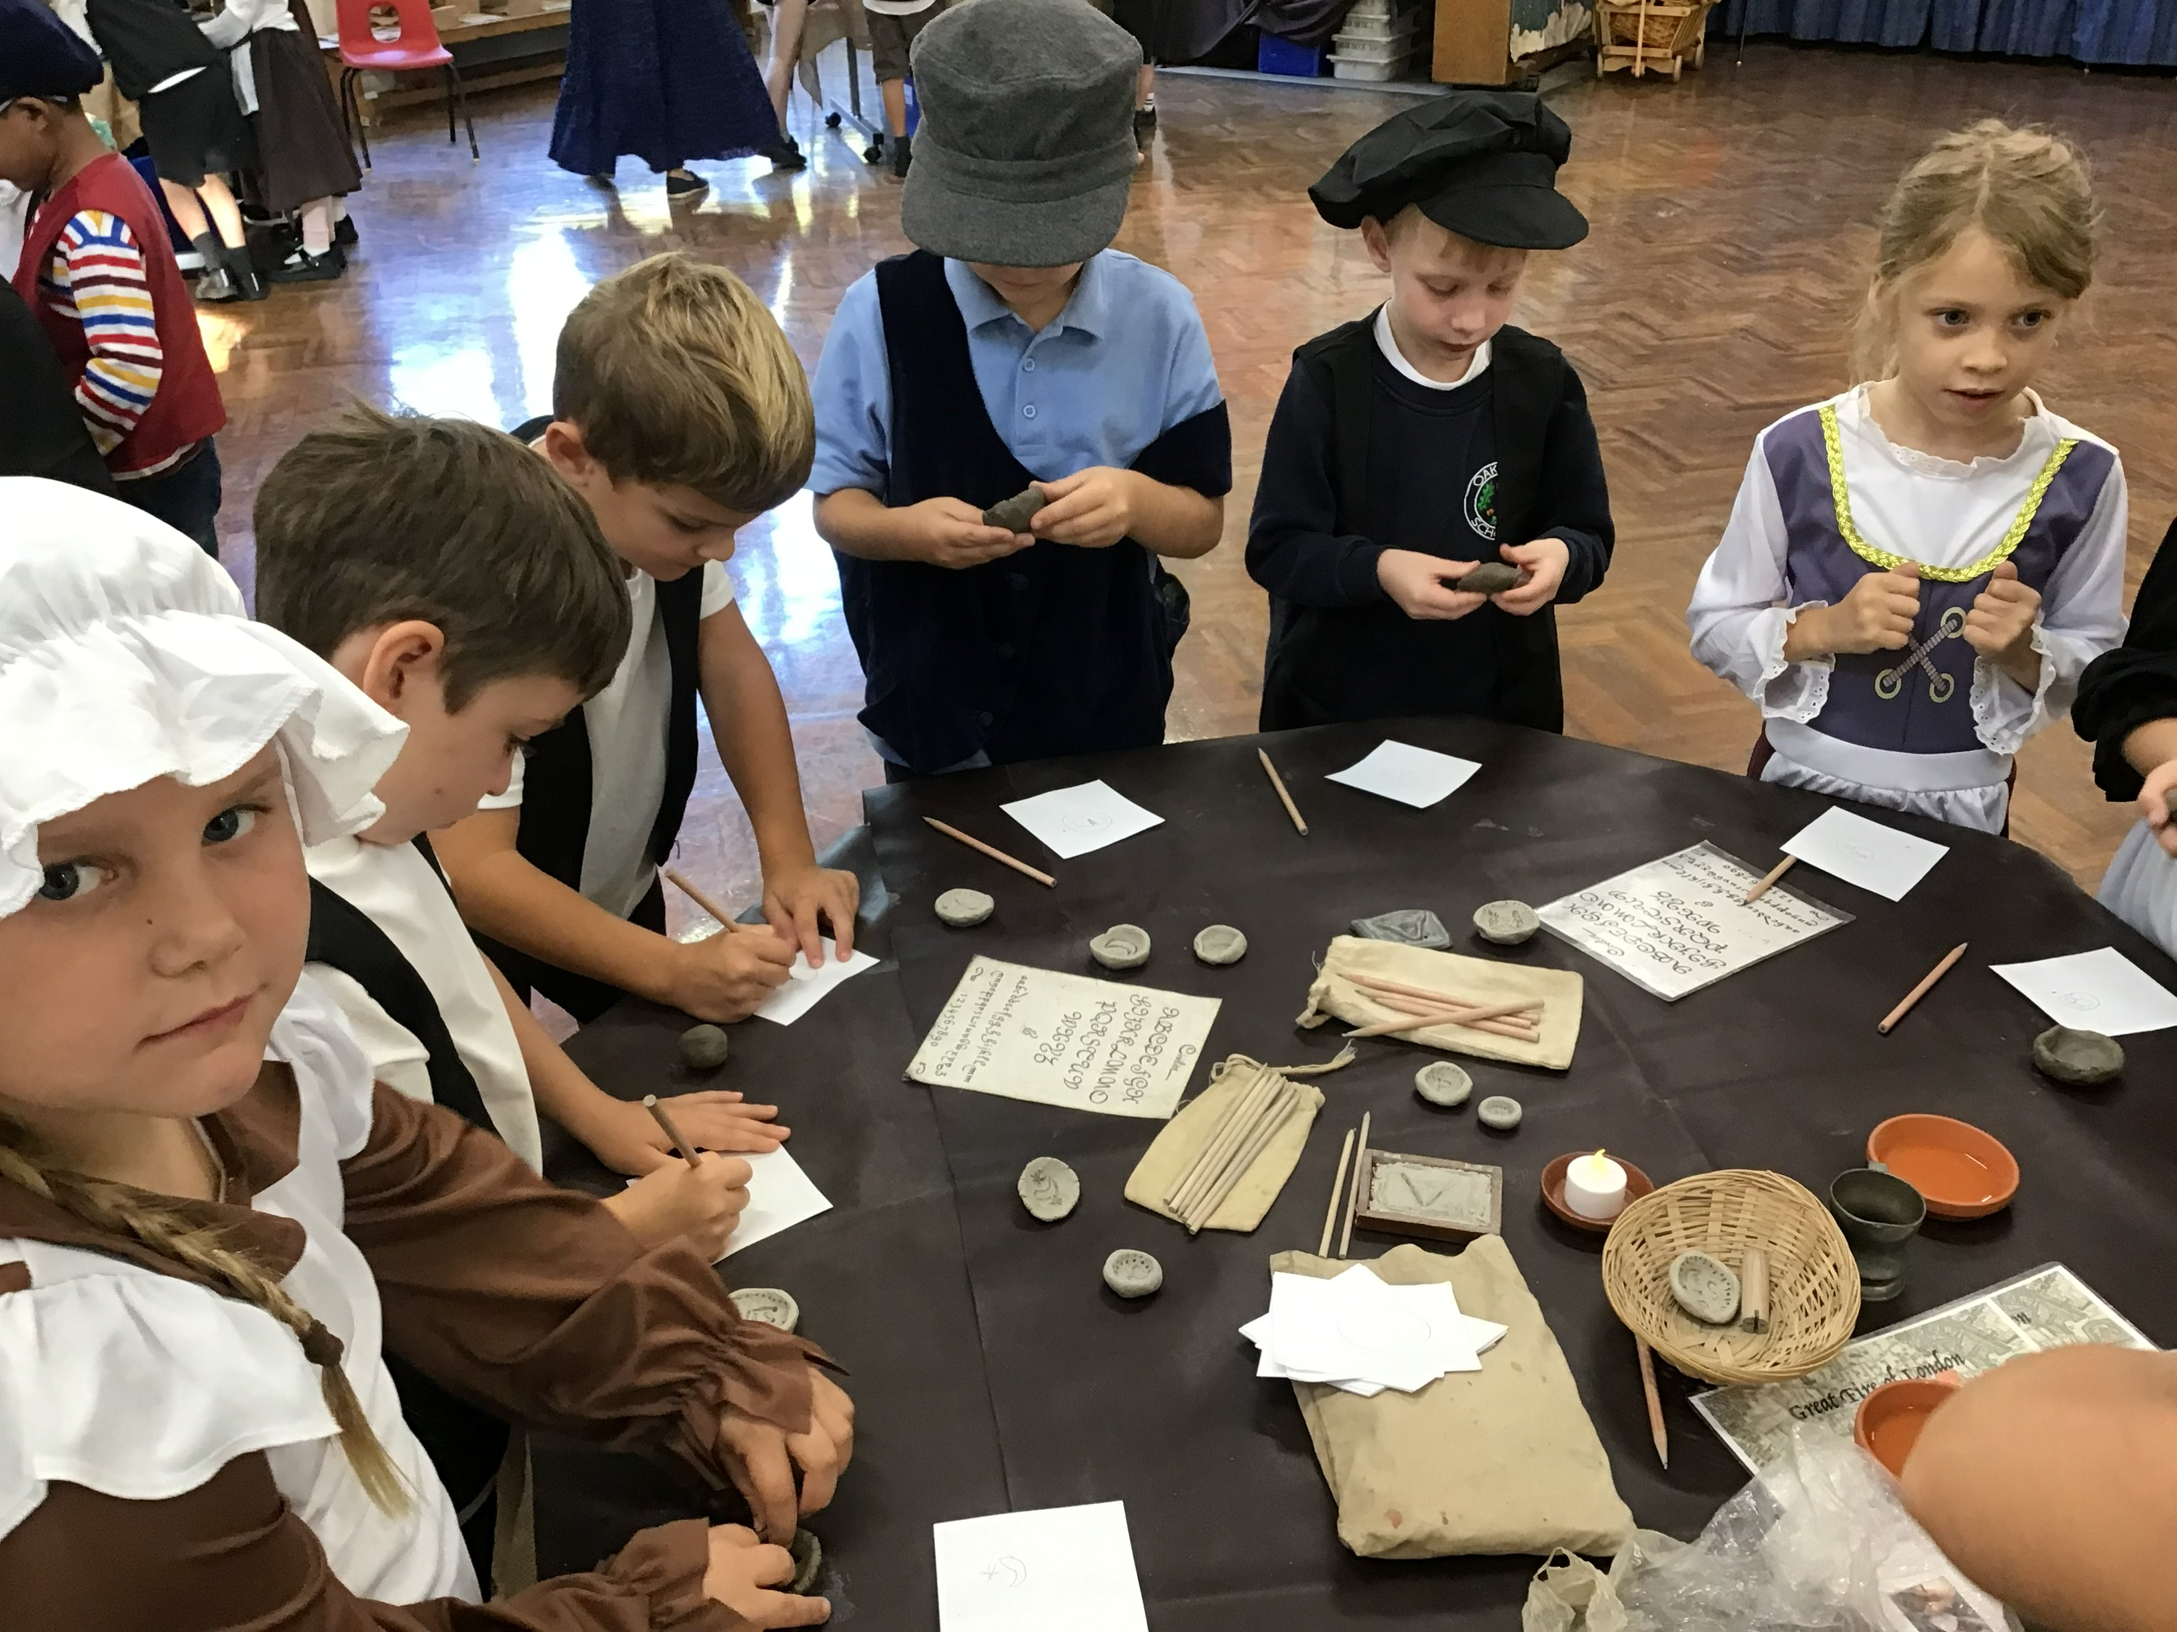
Topics
Autumn Term – Panic in Pudding Lane
Remember Remember
Spring Term - Amazing Africa
Healthy Me
Summer Term – Let’s Invent
Great Outdoors
Visits & Workshops
*Church *African workshop
*Pizza making *Rushall Farm
*Local fieldwork *History Off The Page workshop
*Library

Slide 11
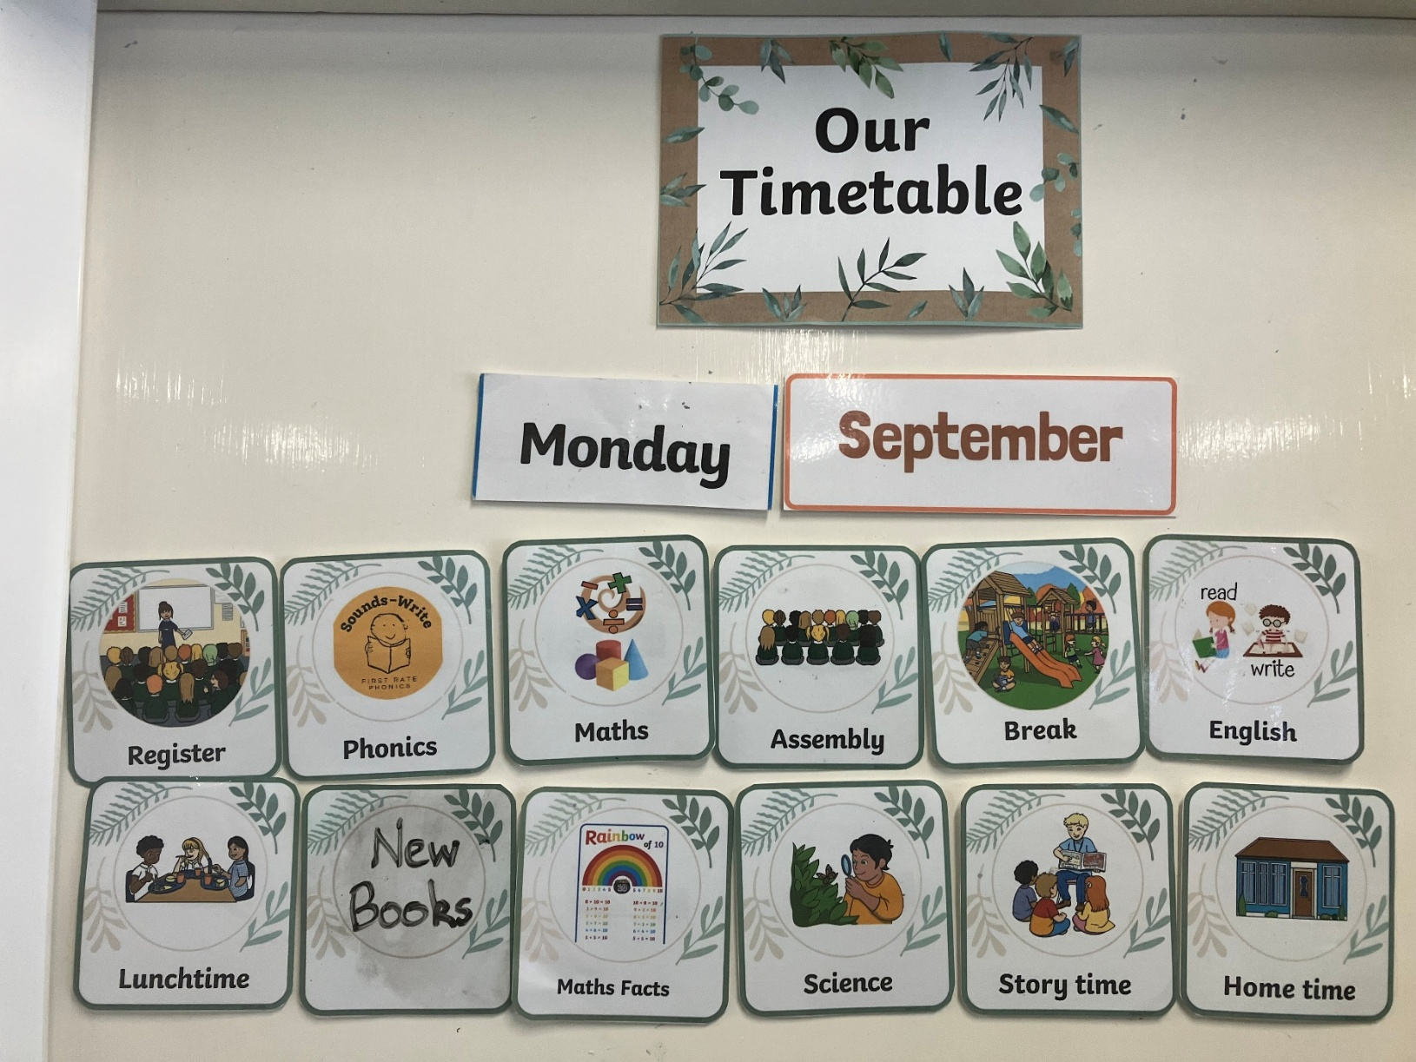
A Typical Busy Day

Slide 12

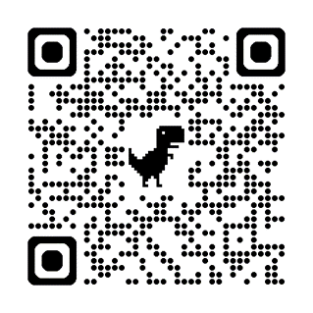
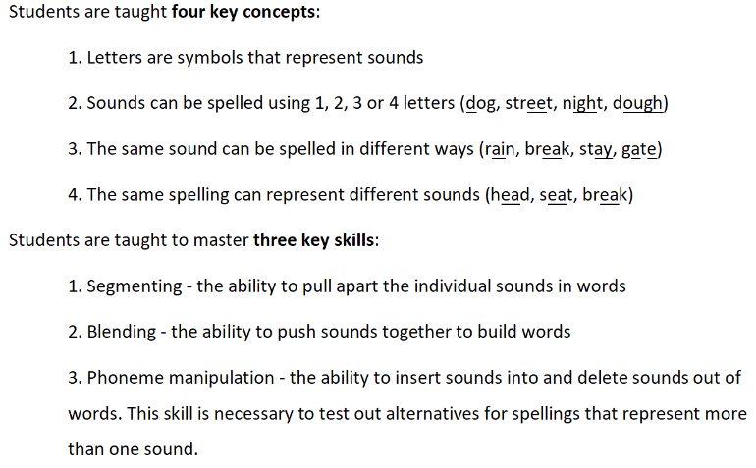
Sounds-Write is our phonics scheme

Slide 13
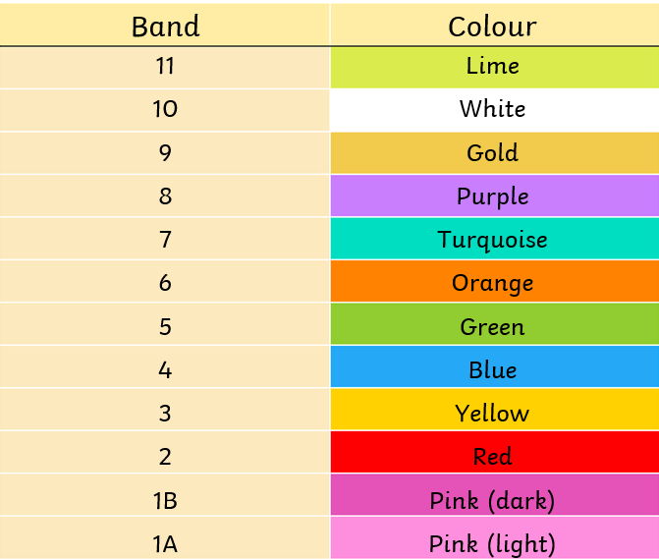

Slide 14
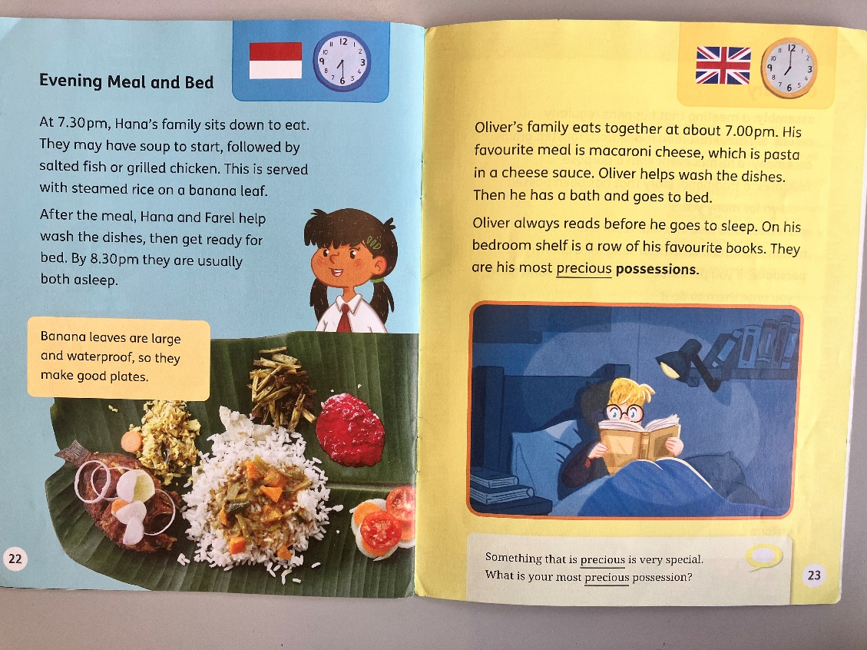
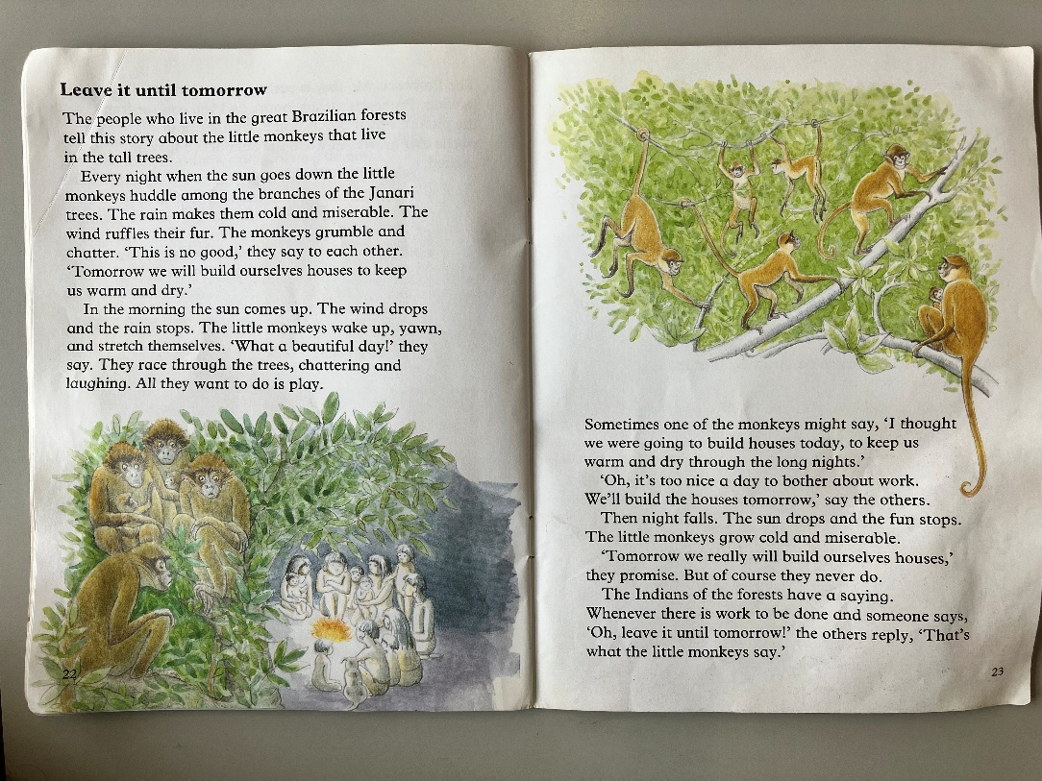
Examples of Gold and White level books

Slide 15
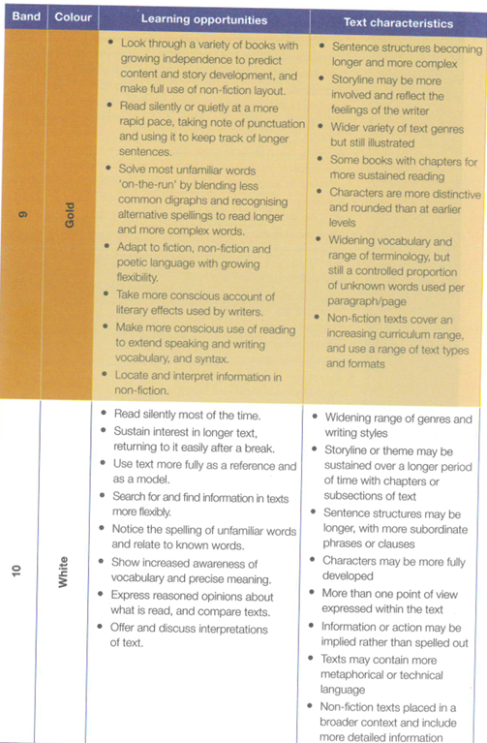
https://peters.co.uk/book-banding

Slide 16
Reading
Children will receive at least two phonic decodable books until they have reached a secure Orange book band level.
They will then receive one phonic book and can choose one book from the colour band box. These will be changed each Monday.
PLEASE write when your child has read their book and where appropriate write a comment as these are useful for our teacher assessment.
Ideally 4 or 5 short sessions of 3 or 4 pages per week are better than one long 'got to read the whole book' session.
We do a mixture of whole class, group and 1:1 reading. Reading also occurs every day naturally throughout the curriculum.

Slide 17
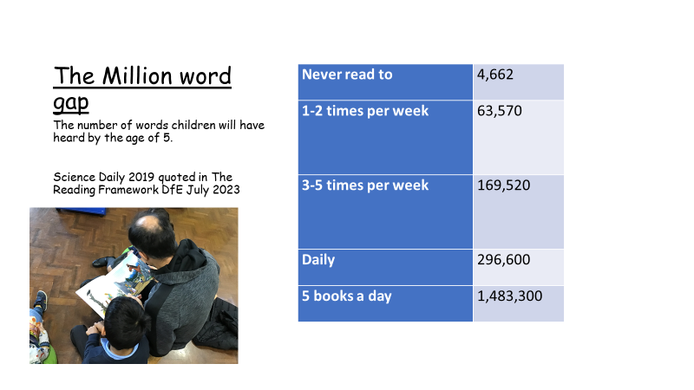

Slide 18

Reading Comprehension

Slide 19

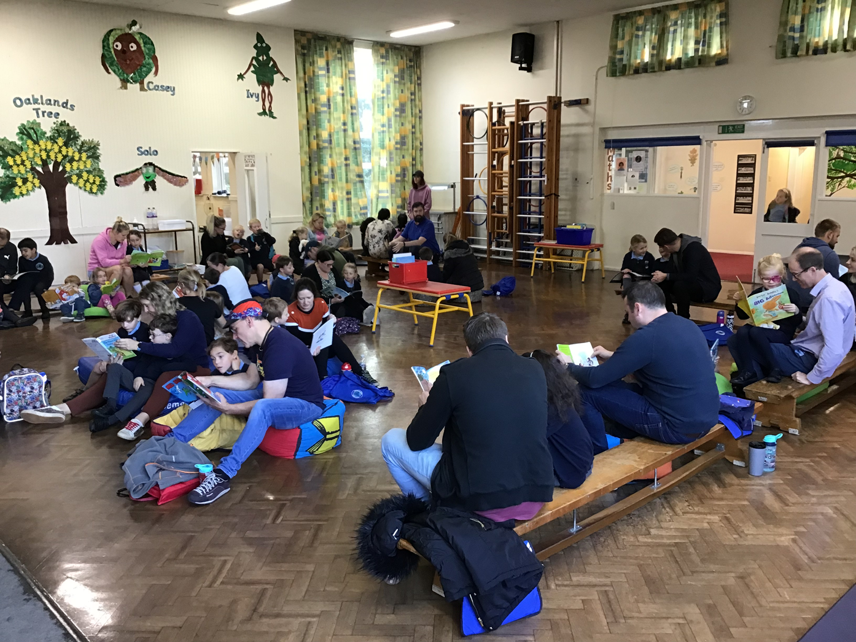
    Dates
Reading Guardian training
Thursday 1st October (9.00)
Reading for Pleasure
  Friday 25th Sept (3.15) [Booknic]
  Wednesday 18th Nov (8.15 onwards) [Hall]

Slide 20

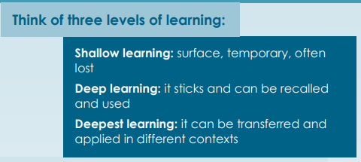
Maths
We use a maths mastery approach.
A mathematical concept or skill has been mastered when a child can show it in different ways, use mathematical language to explain their ideas and independently apply the concept to new problems in unfamiliar situations.

Slide 21
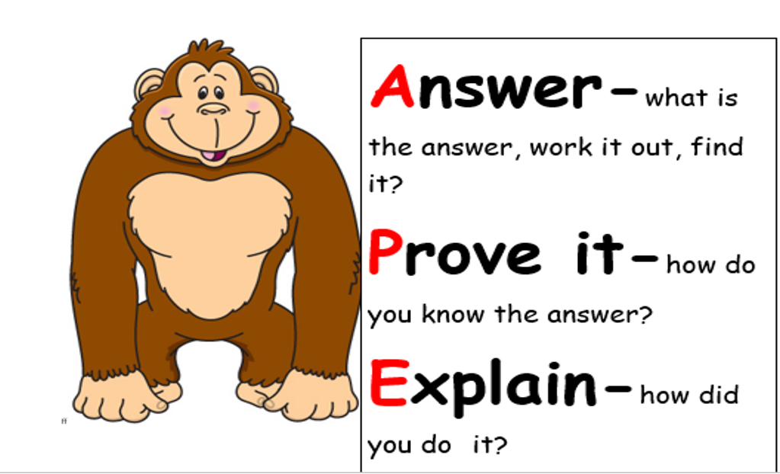
Maths – Proving deeper understanding

Slide 22
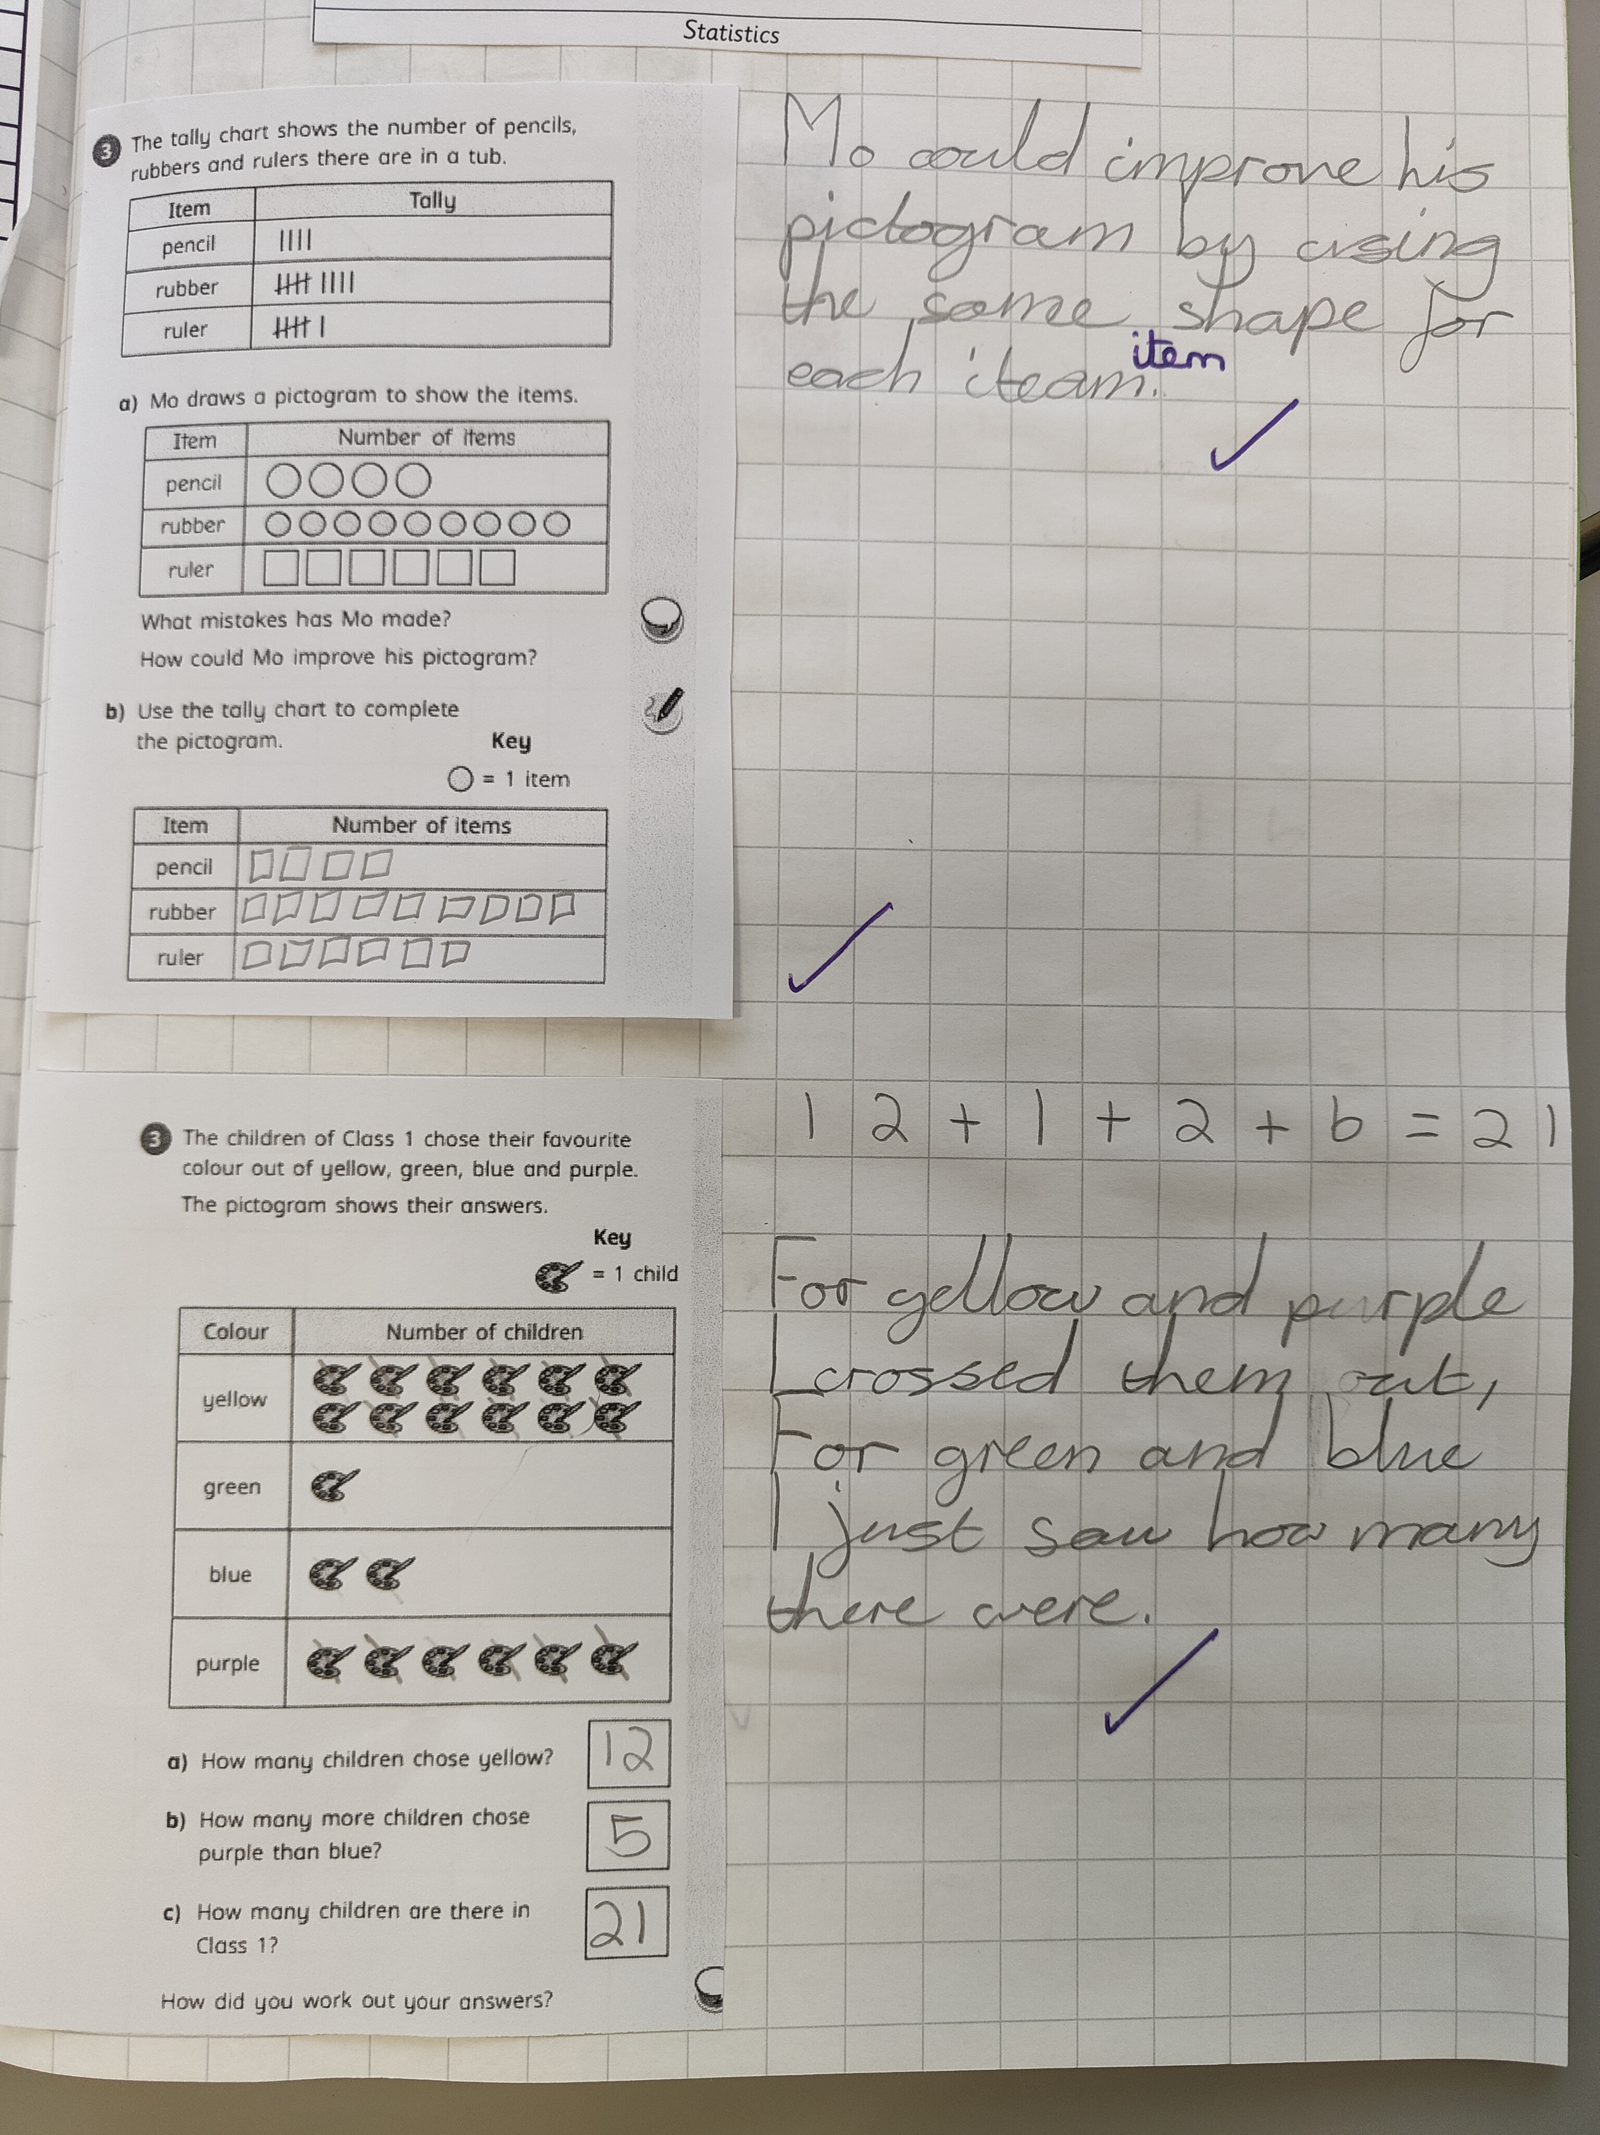
Year 2
Expectations

Slide 23
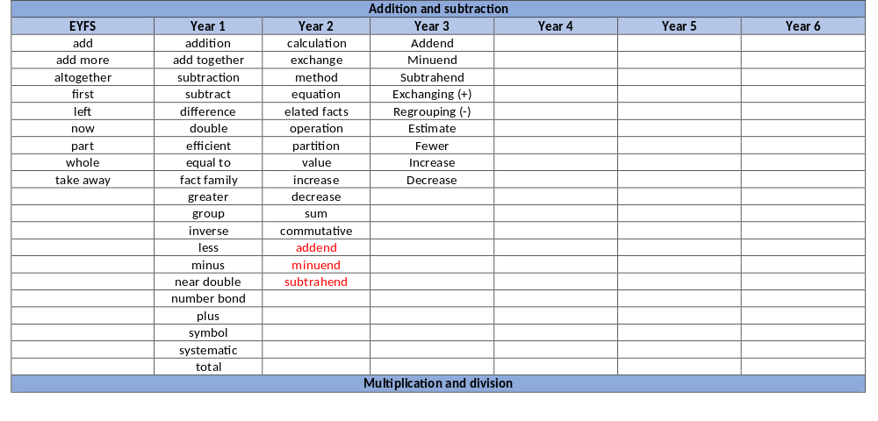
Maths Vocabulary
Example

Slide 24

Maths
www.topmarks.co.uk
www.snappymaths.com
https://whiteroseeducation.com/parent-pupil-resources
White Rose – 1 minute Maths App
www.ictgames.com

Slide 25
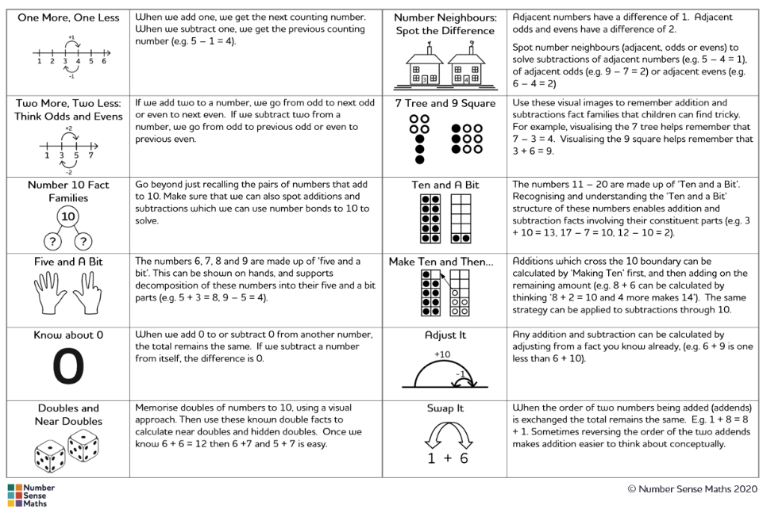

Slide 26

Maths Expectations in Year 2
Examples of recall facts children should know by the end of year 2:
Recall and use the multiplication and division facts for 2x 5x 10x tables
Recall and use number bonds to and within 20
Read and write numbers to 100 in numerals and words
Count in steps of 2, 3, 5 from zero
Count in 10s from any number forwards and backwards

Slide 27

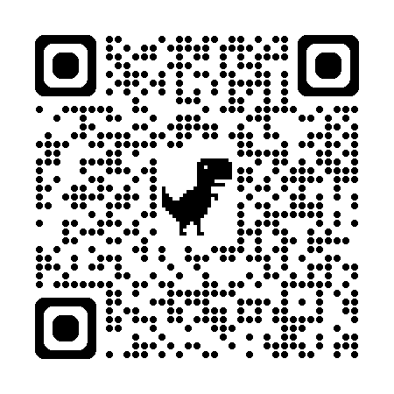
End of Year 2 Writing Expectations
Independent and coherent across a range of pieces
Build writing stamina
Range of punctuation used correctly
Use of conjunctions: and, or, because, but, that, when and if
Handwriting – mostly joined by end of Yr 2
Spelling of most everyday exception words
Language – use ambitious words
I Am A Clever Writer approach
Handwriting posters

Slide 28

  Please encourage your child to use the correct pencil grip. It will make writing a much more comfortable experience in the long run. It is hard to remedy as children get older.
‘Pinch and rest’

Slide 29
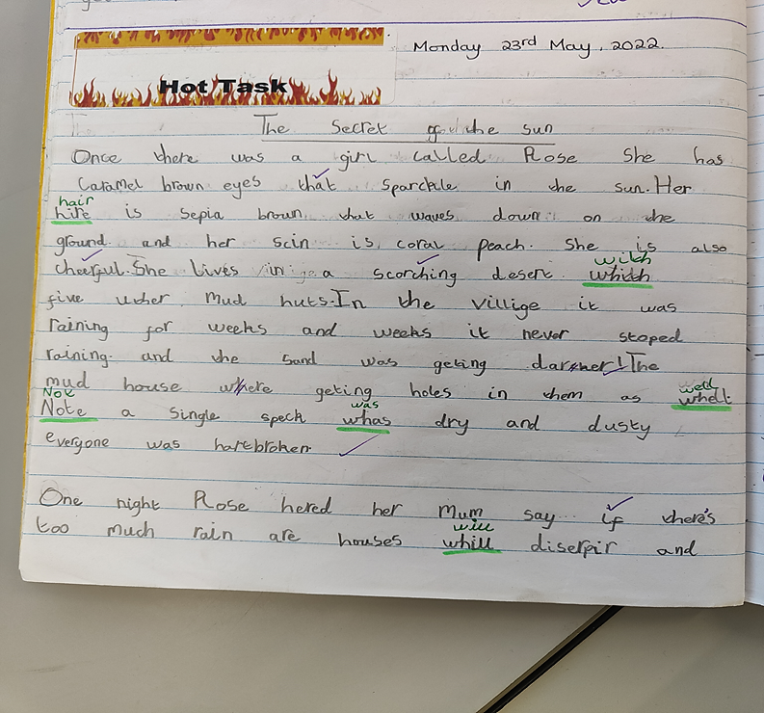
An example of a child working at the ‘expected’ level in Spring Term of Year 2.

Slide 30
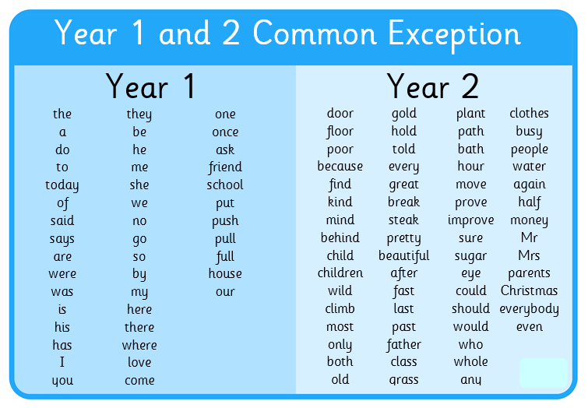
Every Day Words

Slide 31

Spellings
Spellings – we will be looking at a set of every day words each week which the children will work on in class.
Children will complete a spelling challenge the last week of the half term – applying them in sentences.
To be working at expected at the end of the year they must be able to spell most of the Year 2 every day words.

Slide 32

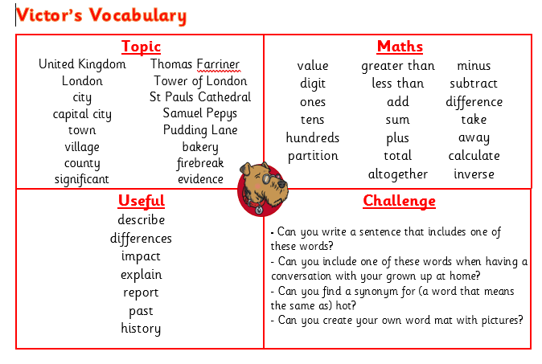
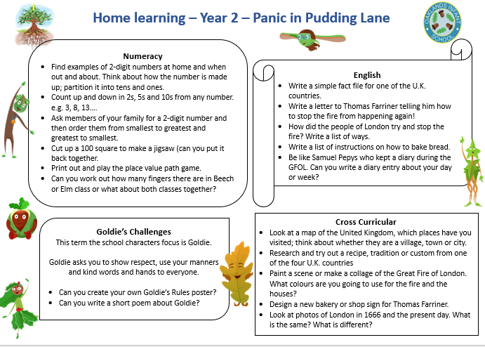
Home Learning
Children in Year 2 are expected to:
read three or more times a week & record in reading record
Spellits – set of 15 spellings (half termly)
Support learning of key instant recall Maths facts
Home Learning grid (on website)
Written reading comprehension from Spring Term

Slide 33



Casey’s Crew
Children in Year 2 can apply to be a member of Casey’s crew to help look after others on the playground during lunchtimes and playtimes.
Children complete application form
Training and regular check ins
Applications have been sent home this week. If your child is interested, please take time to talk about making a commitment and taking a real pride in completing their application.
Return applications by Tuesday 22nd September.

Slide 34

School Council
Year 2 invited to join the School Council.
2 pupils chosen from Elm and 2 from Beech.
Prepare a short speech explaining why they would like to be a representative and what qualities they have.
Election process will begin after half-term.

Slide 35

Working Together
Our door is always open. Please feel free to approach either of us.
Information will be shared on:
  WEDUC
  School website
  Emails
  Parents’ evening
  Newsletters
  Classroom windows
  Notes in Reading diaries

