Slide 1
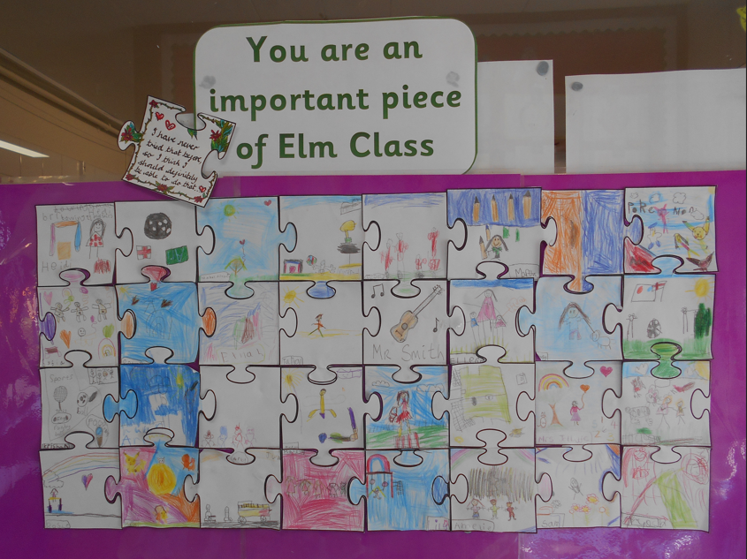
Important Pieces of Elm Class

Slide 2
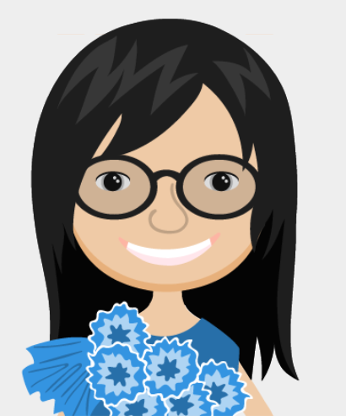
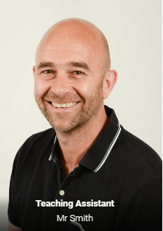
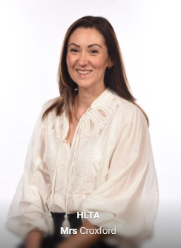
Adults in Elm
Mrs Cracknell

Slide 3
What your child needs every day
Their book bag
A coat to match the weather
Reading books and reading records every day
Water bottle – only water please
Long hair needs to be tied back every day (hair bands to match school colours).

Slide 4
  PE kit - including tracksuit bottoms for cold weather and plimsolls / trainers (that they can do up)
  Please no earrings on PE days or bring tape and teach your child how to use it.
  Big labels on everything please – bottles, PE kit items, bags, etc.

Slide 5

Please keep water bottles out of book bags. We need to keep our books clean and dry for the children.

Slide 6
  Change of pick up arrangements
  Please email the school office if pick up arrangements change or your child has a hospital appointment.

Slide 7
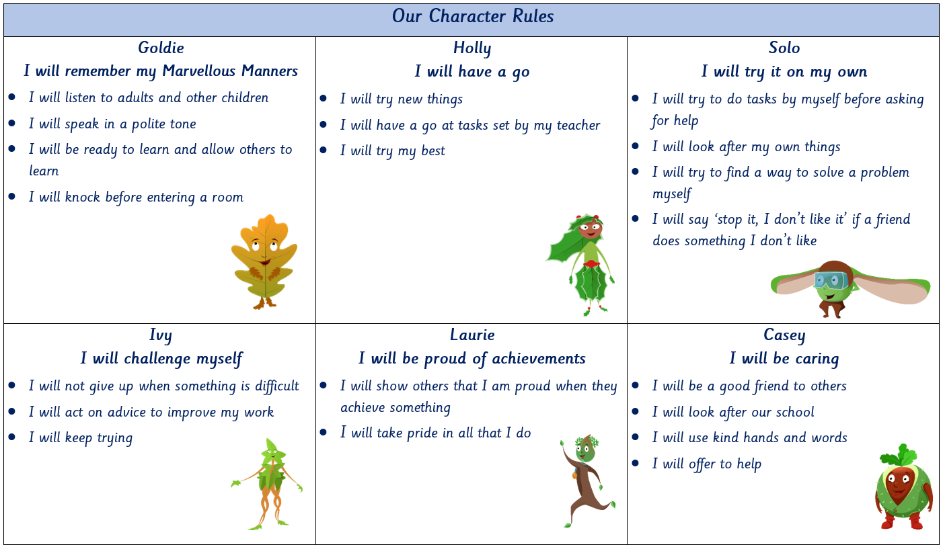

Slide 8


School Termly focus…
Autumn 1 – Goldie
Autumn 2 – Holly
Spring 1 – Solo
Spring 2 – Ivy
Summer 1 – Laurie
Summer 2 – Casey

Slide 9


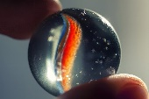

Positive Reinforcement
    Every Monday, two children from each class, who have shown behaviour linked with the current ‘focus’ character, will be awarded a ‘leaf’ in assembly and will have ‘tea’ with Mrs Shrieve later in the week.
    Each week a child will be chosen at random to be our star of the week. All week any of the children can write or draw anything positive about the ‘Star of the Week’.
    The children can individually or as a class earn marbles for making positive choices in their learning and behaviours. Once the marble jar is full, the class vote for their reward e.g. bring a teddy to school, extra playtime etc.
    Each week, one class wins the Class of the Week trophy

Slide 10

The Oaklands Way Circle
All children will start each session with their name
  in the centre circle.
If a child does not meet expectations, they will be given a verbal reminder.
If they continue, their name will be moved to the next circle out from the centre. This is accompanied with an explanation and reminders of how they can get their name back into the centre.
If the behaviour is repeated, they will receive a consequence e.g. moving to a different table to work, time out in a different class or missing a few minutes of a break.
All children will be placed back in the centre at the beginning of each session.

Slide 11
  Topics
  Autumn 1 – Panic in Pudding Lane
  Autumn 2 – Festivals
  Spring 1 – Home and Away
  Spring 2 – Healthy Me
  Summer 1 – A Day in the Life
  Summer 2 – Great Outdoors

Slide 12

Sounds-Write
1. Letters are symbols that represent sounds.
2. A sound may be spelled by 1, 2, 3 or 4 letters.
dog street night dough
3. The same sound can be spelled in more than one way.
rain break gate stay
4. Many spellings can represent more than one sound.
head seat break

Slide 13
We spend a lot of time teaching the skills of reading and listening to the children read.
Regular phonics sessions
Tapping in Reading / Guided Reading (in a group)
One to one reading with an adult
In Year 2, there is a strong focus on comprehension skills as well as phonics skills.

Slide 14
Home Reading
Books are changed on Mondays.
If they are ready, children choose two colour banded books and they are given one decodable book.
Lots of home reading please, we can teach the skills but regular practice is essential.
Please record if they have read with you – a signature is fine.
4 or 5 short sessions of 3 or 4 pages are better than one long 'got to read the whole book' session.
It’s important to have a relaxed, enjoyable read at home.

Slide 15
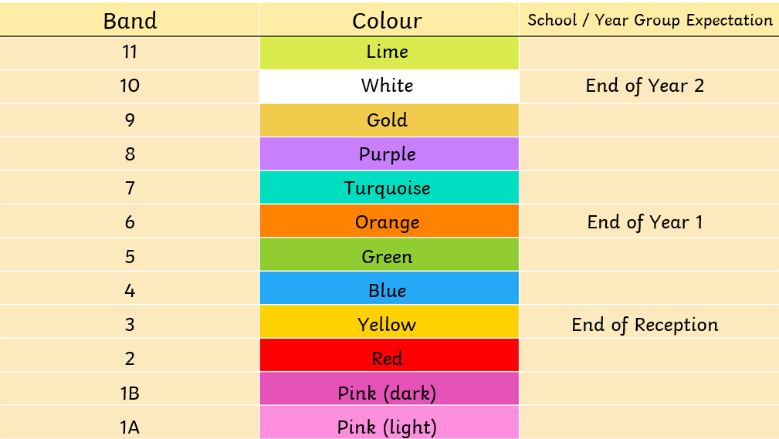

Slide 16
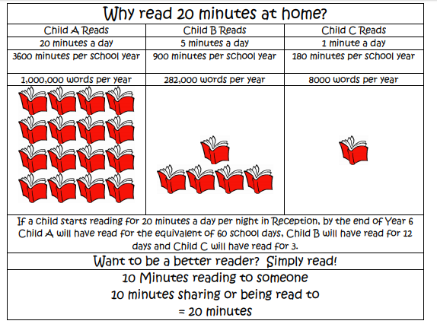

Slide 17
Spelling
Taught in phonics
Taught as part of English lessons
There will be an assessment on some of the Year 2 words at the end of each half term and to see if they apply them within dictated sentences.

Slide 18
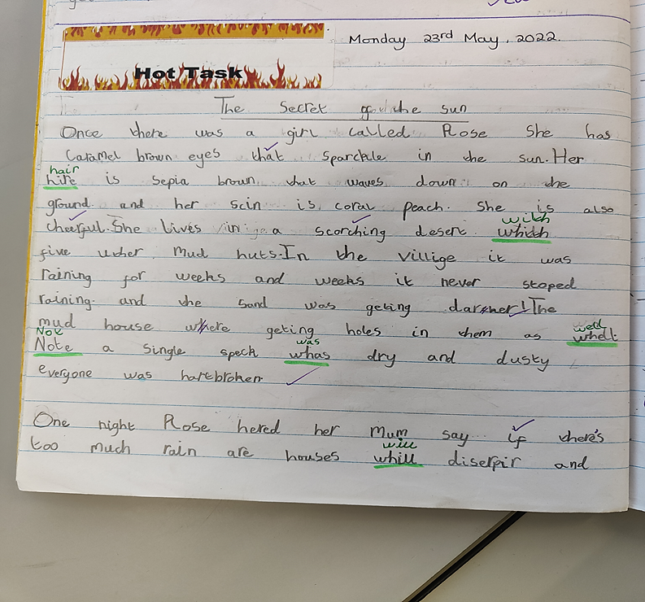
An example of a child working at the ‘expected’ level in Spring Term of Year 2.
Notes:
It’s got to be coherent and consistent size of handwriting. Spelling is a big element, have to be phonetically plausible and Year 2 words spelt correctly. They also need FS, CL and Qu marks consistently.
Children cannot sustain the rate of progress over two years to continue to be Greater depth.
Writing is the area where expectations increase the most from Year 1. By the end of the year an expected year 2 writer should be able to write independently and coherently across a range of pieces. Children’s stamina has to increase quite considerably.

Slide 19

  Please encourage your child to use the correct pencil grip. It will make writing a much more comfortable experience in the long run. It is hard to remedy as they get older.
‘Pinch and rest’

Slide 20
Maths
  We use a maths mastery approach.
  Underlying number knowledge is key, we do not just carry out lists of calculations as this does not build deep understanding.
  Maths is not all about numbers – e.g. days of the week and shape

Slide 21
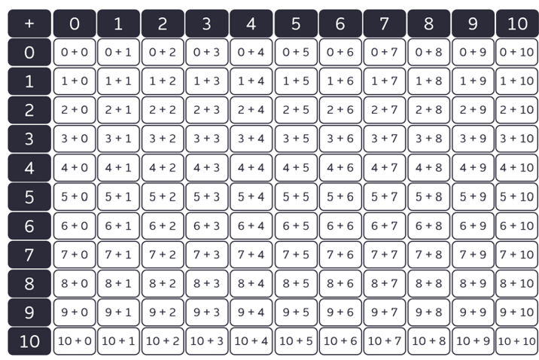
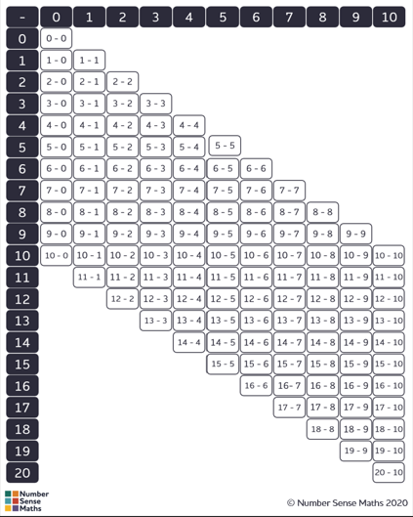
Maths Fluency Facts
Key Maths Facts
Key facts are sente home at the beginning of each half term.
Then we will assess the children at the end of each half term.
The assessments will be sent home so that you can support your child in the areas they found tricky.

Slide 22
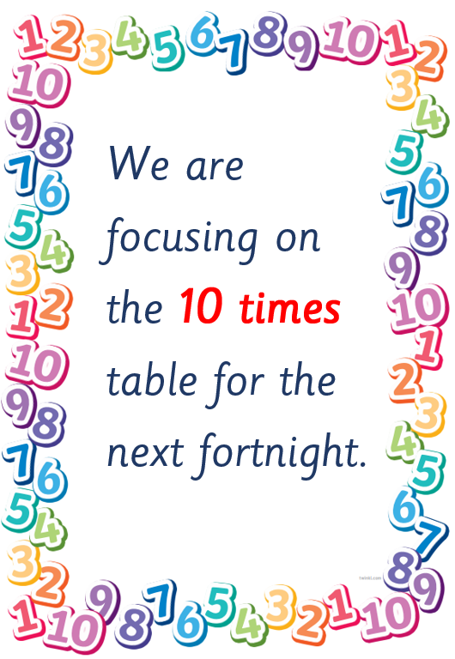
Multiplication Facts
By the end of Year 2, the children are expected to instantly recall facts for the 2-, 5- and 10-times tables including corresponding division facts.
Each fortnight, the children will work through a timed challenge. You will be able to see what the current multiplication focus is by checking signs displayed in the classroom window.
Overview for the Year
Autumn 1 – Counting in 2s, 5s, and 10s
Autumn 2 – Ten times table
Spring 1 - Two times table
Spring 2 – Five times table
Summer Term – Mixed (2s, 5s, and 10s) plus associated division facts

Slide 23

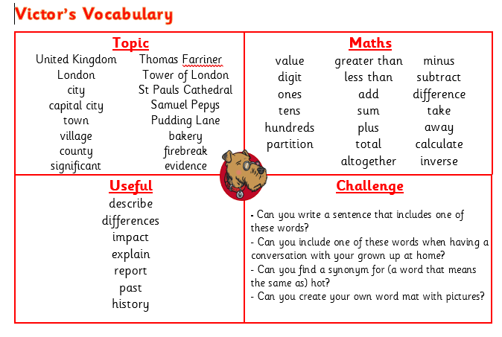
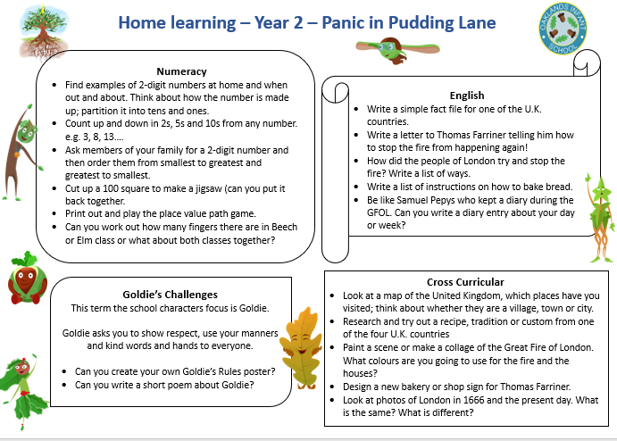
Home Learning
Children in Year 2 are expected to:
Read – minimum 3 times per week
Practise Year 2 everyday words
Practise counting in 2s, 5s and 10s
Practise times tables facts for 2s, 5s and 10s
Practise maths fluency – number bonds, doubles, halves
Optional - Home Learning Grid

Slide 24
What to do if your child is having difficulties
You are welcome to email me via the school office. If I can’t help, I can access the right person for you.
Please feel free to contact me about any concerns you may have about your child, not just academic difficulties.
Catch up with me at Parents’ Evening in October.

Slide 25


Casey’s Crew
Children in Year 2 can apply to be a member of Casey’s Crew to help look after others on the playground during lunchtimes and playtimes.
There will be training and regular check ins with Miss Davies.
Children complete an application form.
Applications to be returned by Tuesday 22nd September. If your child is interested, please take time to talk about making a commitment and taking a real pride in completing their application.
We also vote for two children to be our school council representatives later in the year.

Slide 26

School arrangements for birthdays.
Please no sweets or cakes. Instead your child can wear non-school uniform on their birthday.

Slide 27
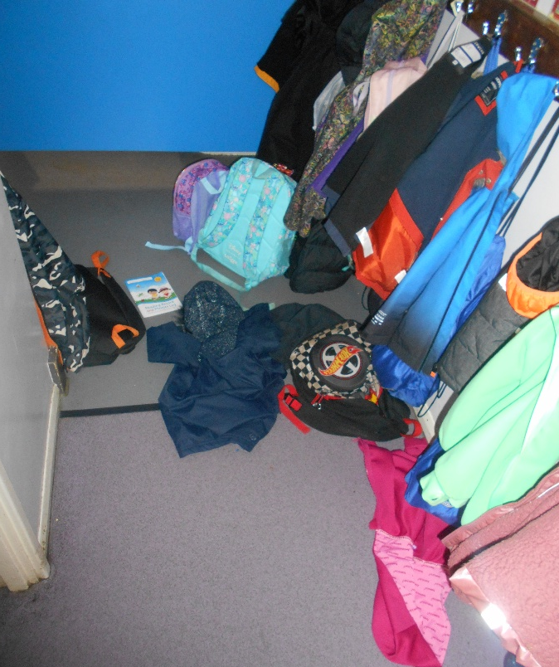
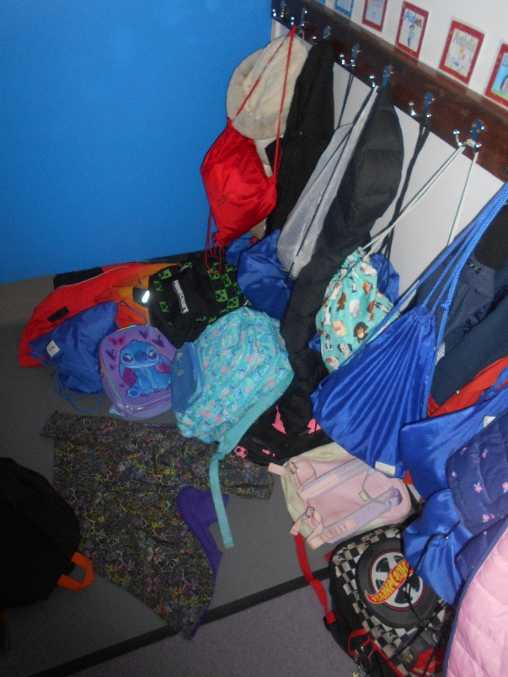
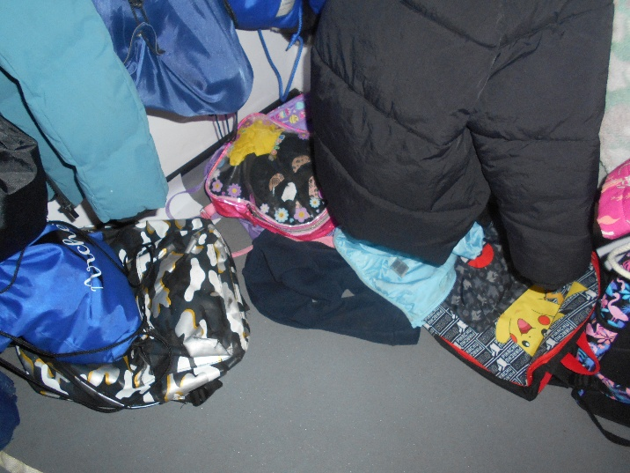
Cloakroom

Slide 28
Cloakroom
Please do not bring ‘special’ much loved items into school.
Preferably a bookbag not a rucksack
Maintain loops on coats and cardigans
Encourage children to keep their bags done up

Slide 29
Miscellaneous
Elm with have a Celebration assembly on Thursday 22nd October
Mrs Thuambe will run a session for new reading guardians on Thursday 1st October at 8:50am.
Coffee Morning on 23rd September: This will be an opportunity to hear about the school's priorities for the year, meet the Assistant Heads, and connect with other parents.
WhatsApp groups can be useful for sharing information but they can sometimes lead to misunderstandings. Please speak directly to me if you have questions or concerns.
Parent Representatives: We are looking for a parent representative for each year group. This is a great opportunity for parents to become more involved in school life. A letter has gone out. We are looking to appoint one representative for each class.

Slide 30
Where can you find information?
School website
School emails
Home Learning Grids – on the website and the link is sent out in the newsletters
Parents’ evening 20th and 22nd October
Newsletters
Your WEDUC account

Slide 31
Any Questions?

