Slide 1

Welcome to the Foundation Stage

Slide 2

Staffing
Teachers:
Mrs Virgo & Miss Pike - Ash
Mrs Whibley - Willow
Teaching Assistants:
Mrs Hinchin
Mrs Williams/Mrs Heard
Miss Dyer
PPA cover:
Mrs Croxford
Mrs Peters

Slide 3

Independence/Life Skills
Ratios
Toileting
Dressing and Undressing
Looking after Belongings
Knife and Fork
Nose Blowing!
With independence comes confidence
Home/School Partnership

Slide 4

Organisation of the day
Small group
Phonics
Free-flow - the importance of play
Whole class lessons- PHSE, Music, ICT, PE, RE
Daily show and tell
Whole school assemblies – to
start after half term

Slide 5

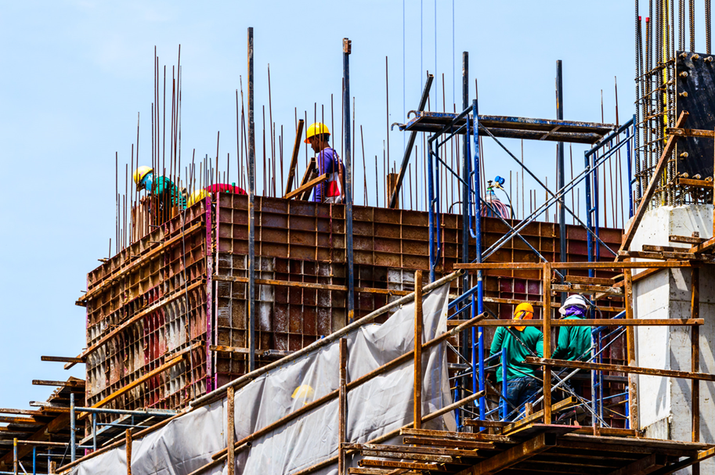
Maths Mastery
Depth
Subitising
Mastering Number programme - Numberblocks
“If we want children to be successful in maths the foundations in all areas need to be solid otherwise later on, understandingsof concepts will crumble…”

Slide 6


Reading
Daily Phonics
Correct pronunciation of sounds sounds write video for parents - Google Search
Individual and group reading at
school
Reading books changed weekly on Mondays
Sign reading records – minimum 3 x week
Please keep reading books, reading record and library books in book bags

Slide 7
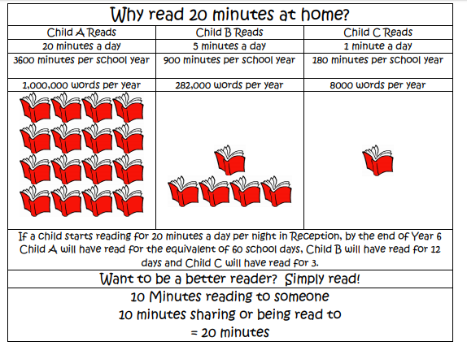

Slide 8

Sounds-Write
Sounds Write is a linguistic phonics programme. It begins with the sounds in the language and moves from the sounds to the written word.
Children will learn the skills of blending to read and segmenting to spell. They will also learn to manipulate sounds (swap one sound for another in a word)
Initial code – single sounds
Extended code – sounds represented by more than one spelling and more than one letter. Spellings represented by more than one sound.
Sight words “everyday words”.

Slide 9
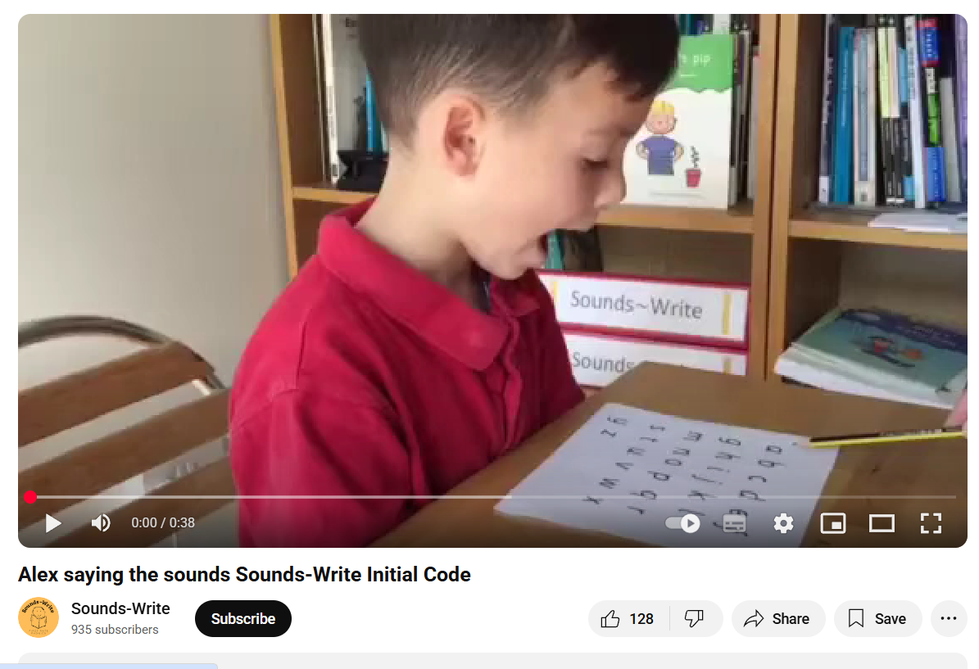

Slide 10
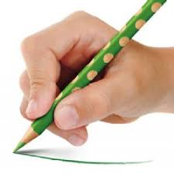
Writing
Fine motor control
Handwriting - do not join!
Model writing correctly - no capitals
Importance of correct pencil grip.
Approach to writing and Drawing Club – more to follow

Slide 11

Assessment
Baseline assessment
Observations
Learning Journeys - Tapestry
Partnership between school and home.
Observations from home - Proud Clouds

Slide 12

Differentiation
Extra support
Home Learning sheets
Knowledge organisers
Celebration of Learning – each term
Sharing Assembly - Summer Term
Parents Evening
Reports – Summer Term

Slide 13







Behaviour
Visions and Values
Positive – Character award, stickers, marble jar
Encourage own problem solving skills
Catch them being good!
Come and talk to us if you are concerned

Slide 14

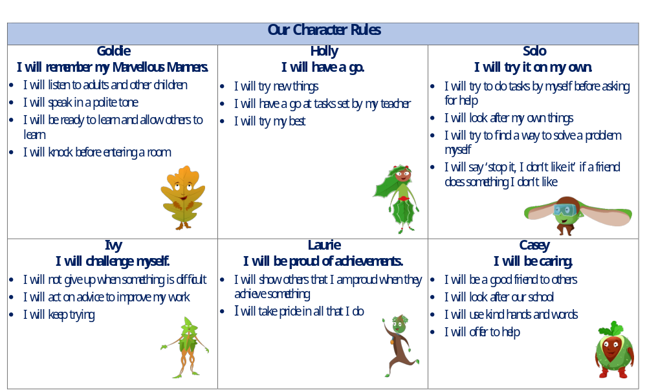
Oaklands Way
We will talk to you if there is a problem

Slide 15
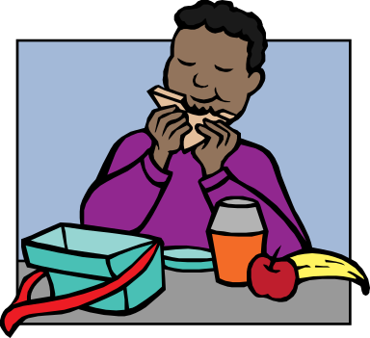
Food
  A fruit or vegetable snack is provided for all children.
  Not too much food in lunchboxes
  No nuts - Nutella/Peanut butter/cereal bars containing nuts
  No chocolate or sweets
  Other allergies, conditions
  No sharing of food
  Water only in bottles

Slide 16

Housekeeping
Absence - please inform school by 8.50am (each day of absence)
Illness – 48 rule
Letters - check email regularly
Check book bags daily
No water bottles in book bags
Label everything!
Hats and suncream!
Wellies
No jewellery
No big bags/ rucksacks

Slide 17

Housekeeping
Playground equipment
Headlice - check weekly
Long hair - tied back
Remove earrings on PE days.
Regular arrangements for collection
Other people collecting
Volunteers-governors, helping hands,
Library, gardening, PTA
E-safety
Social media/Whatsapp

