Slide 1





Welcome to Year One
2026

Slide 2

Staff
Chestnut
Mrs Somerville
Silver Birch
Miss Devereaux– Monday, Tuesday, Wednesday
Mrs Thuambe – Thursday, Friday
PPA – alternate Thursdays
Chestnut – Mrs Croxford
Silver Birch – Mrs Peters
Support staff
Mrs Cracknell
Mrs Toublic
Mrs Blair
Mr Jolliffe
Mr Gunn
Mrs Peters
SENDCo – Mrs Bunce Family support worker – Mrs Lennon

Slide 3

Things to bring into school each day …
Reading books and reading record in book bag - 1 small flat key ring only
Water bottle NEVER in book bag. (no juice)
Coat
Further general information
NAME EVERYTHING
Long hair should be tied up every day including on non-uniform days. Hairbands plain.
Ear rings – plain studs only. Please remove on PE days - see class room window
Birthdays – no sweets etc, your child can wear their own clothes.
Footwear on non-uniform days should still be suitable for running, climbing etc, no laces unless your child can tie them.
Let us know any change to pick up arrangements – written note or through office
Check your child’s book bag for letters & check your WEDUC account
Playground equipment is ONLY for supervised use during school hours.
Children are encouraged to use the toilets at the beginning of the day, playtimes and lunchtimes, or during breaks between lessons.

Slide 4
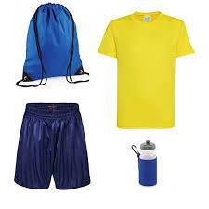
PE
Tuesday
Yellow or blue t-shirt/blue shorts
Plimsolls/trainers
Joggers/sweatshirt for colder days
Socks if girls wear tights to school
Remove ear rings or provide tape & cover them up.
NAME EVERYTHING
Kit stays on peg until the holiday
Check sizing each holiday – can your child easily get their uniform & PE kit on & off.
Check name label can still be read.

Slide 5

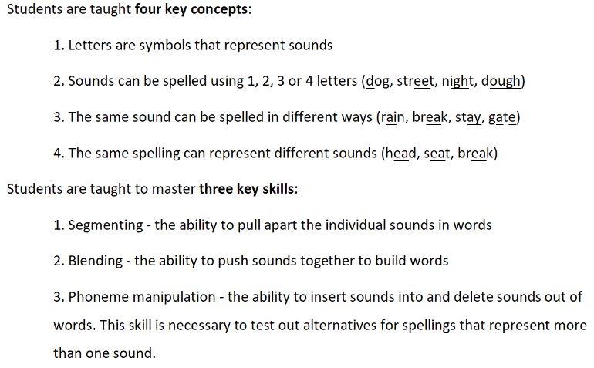
Sounds~write is our phonics scheme
Starts with what children learn naturally – the sounds of their own language
Teaches them how those sounds are represented in writing.

Slide 6

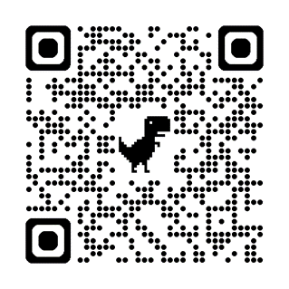

Sounds-Write
Weekly books. 1 phonics book, 1 library book
Read the phonics book at least 3 times. Repetition helps confidence and fluency.
PLEASE sign the reading record book every time you read together.
Alex saying the sounds Sounds-Write Initial Code – YouTube
We encourage ALL parents/carers to access the online course
Free Early Childhood Education Tutorial - Help your child to read and write | Udemy
Ipad app

Slide 7


Slide 8

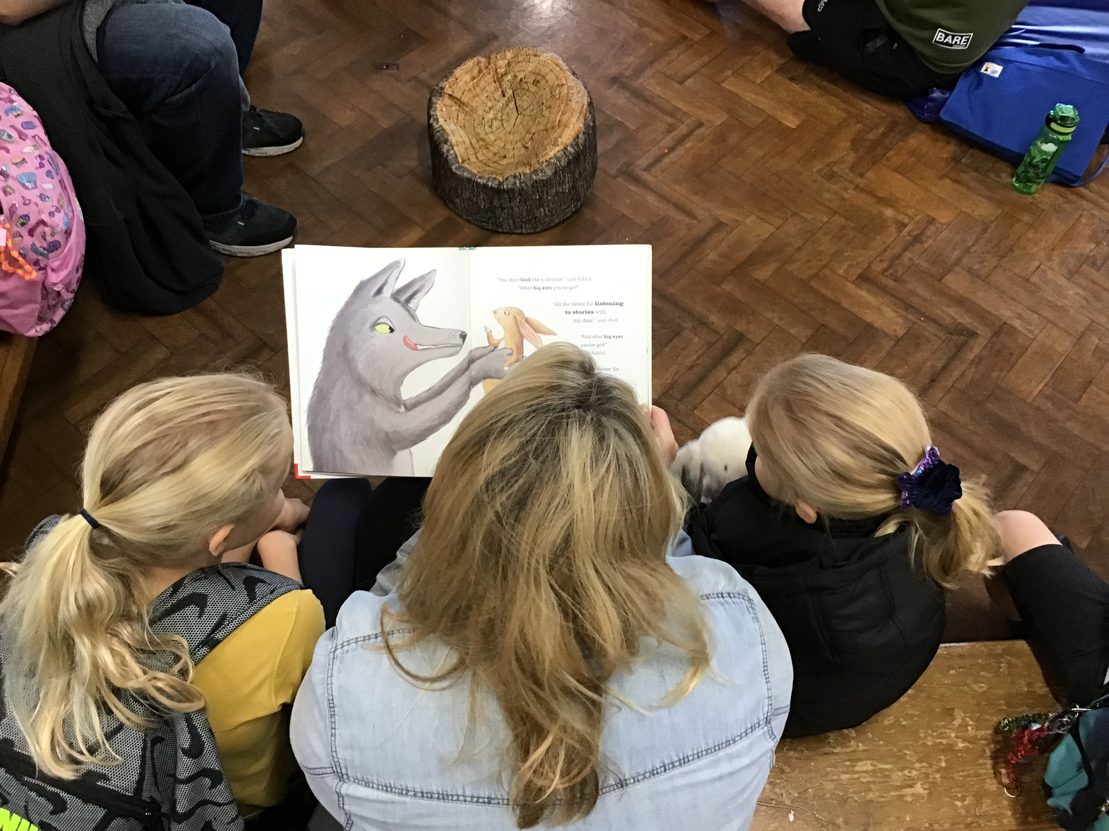
    Books
Library book – look at these together, read to your child, talk about the pictures, ask questions.
Speak in full sentences and model answers in full sentences.
Library day - Silver Birch Thursday. Chestnut Friday. Can you help?
Phonics book – read at least 3 times and date each time.

Slide 9

    Dates
Reading for Pleasure Booknic
  Friday 25th September 3:15-4:00pm
Reading Guardian training
Thursday 1st October 8.50
Y1 Parent workshop phonics & reading
  Friday 16th October 1.30pm

Slide 10

Reading Comprehension
VIPERs

Slide 11
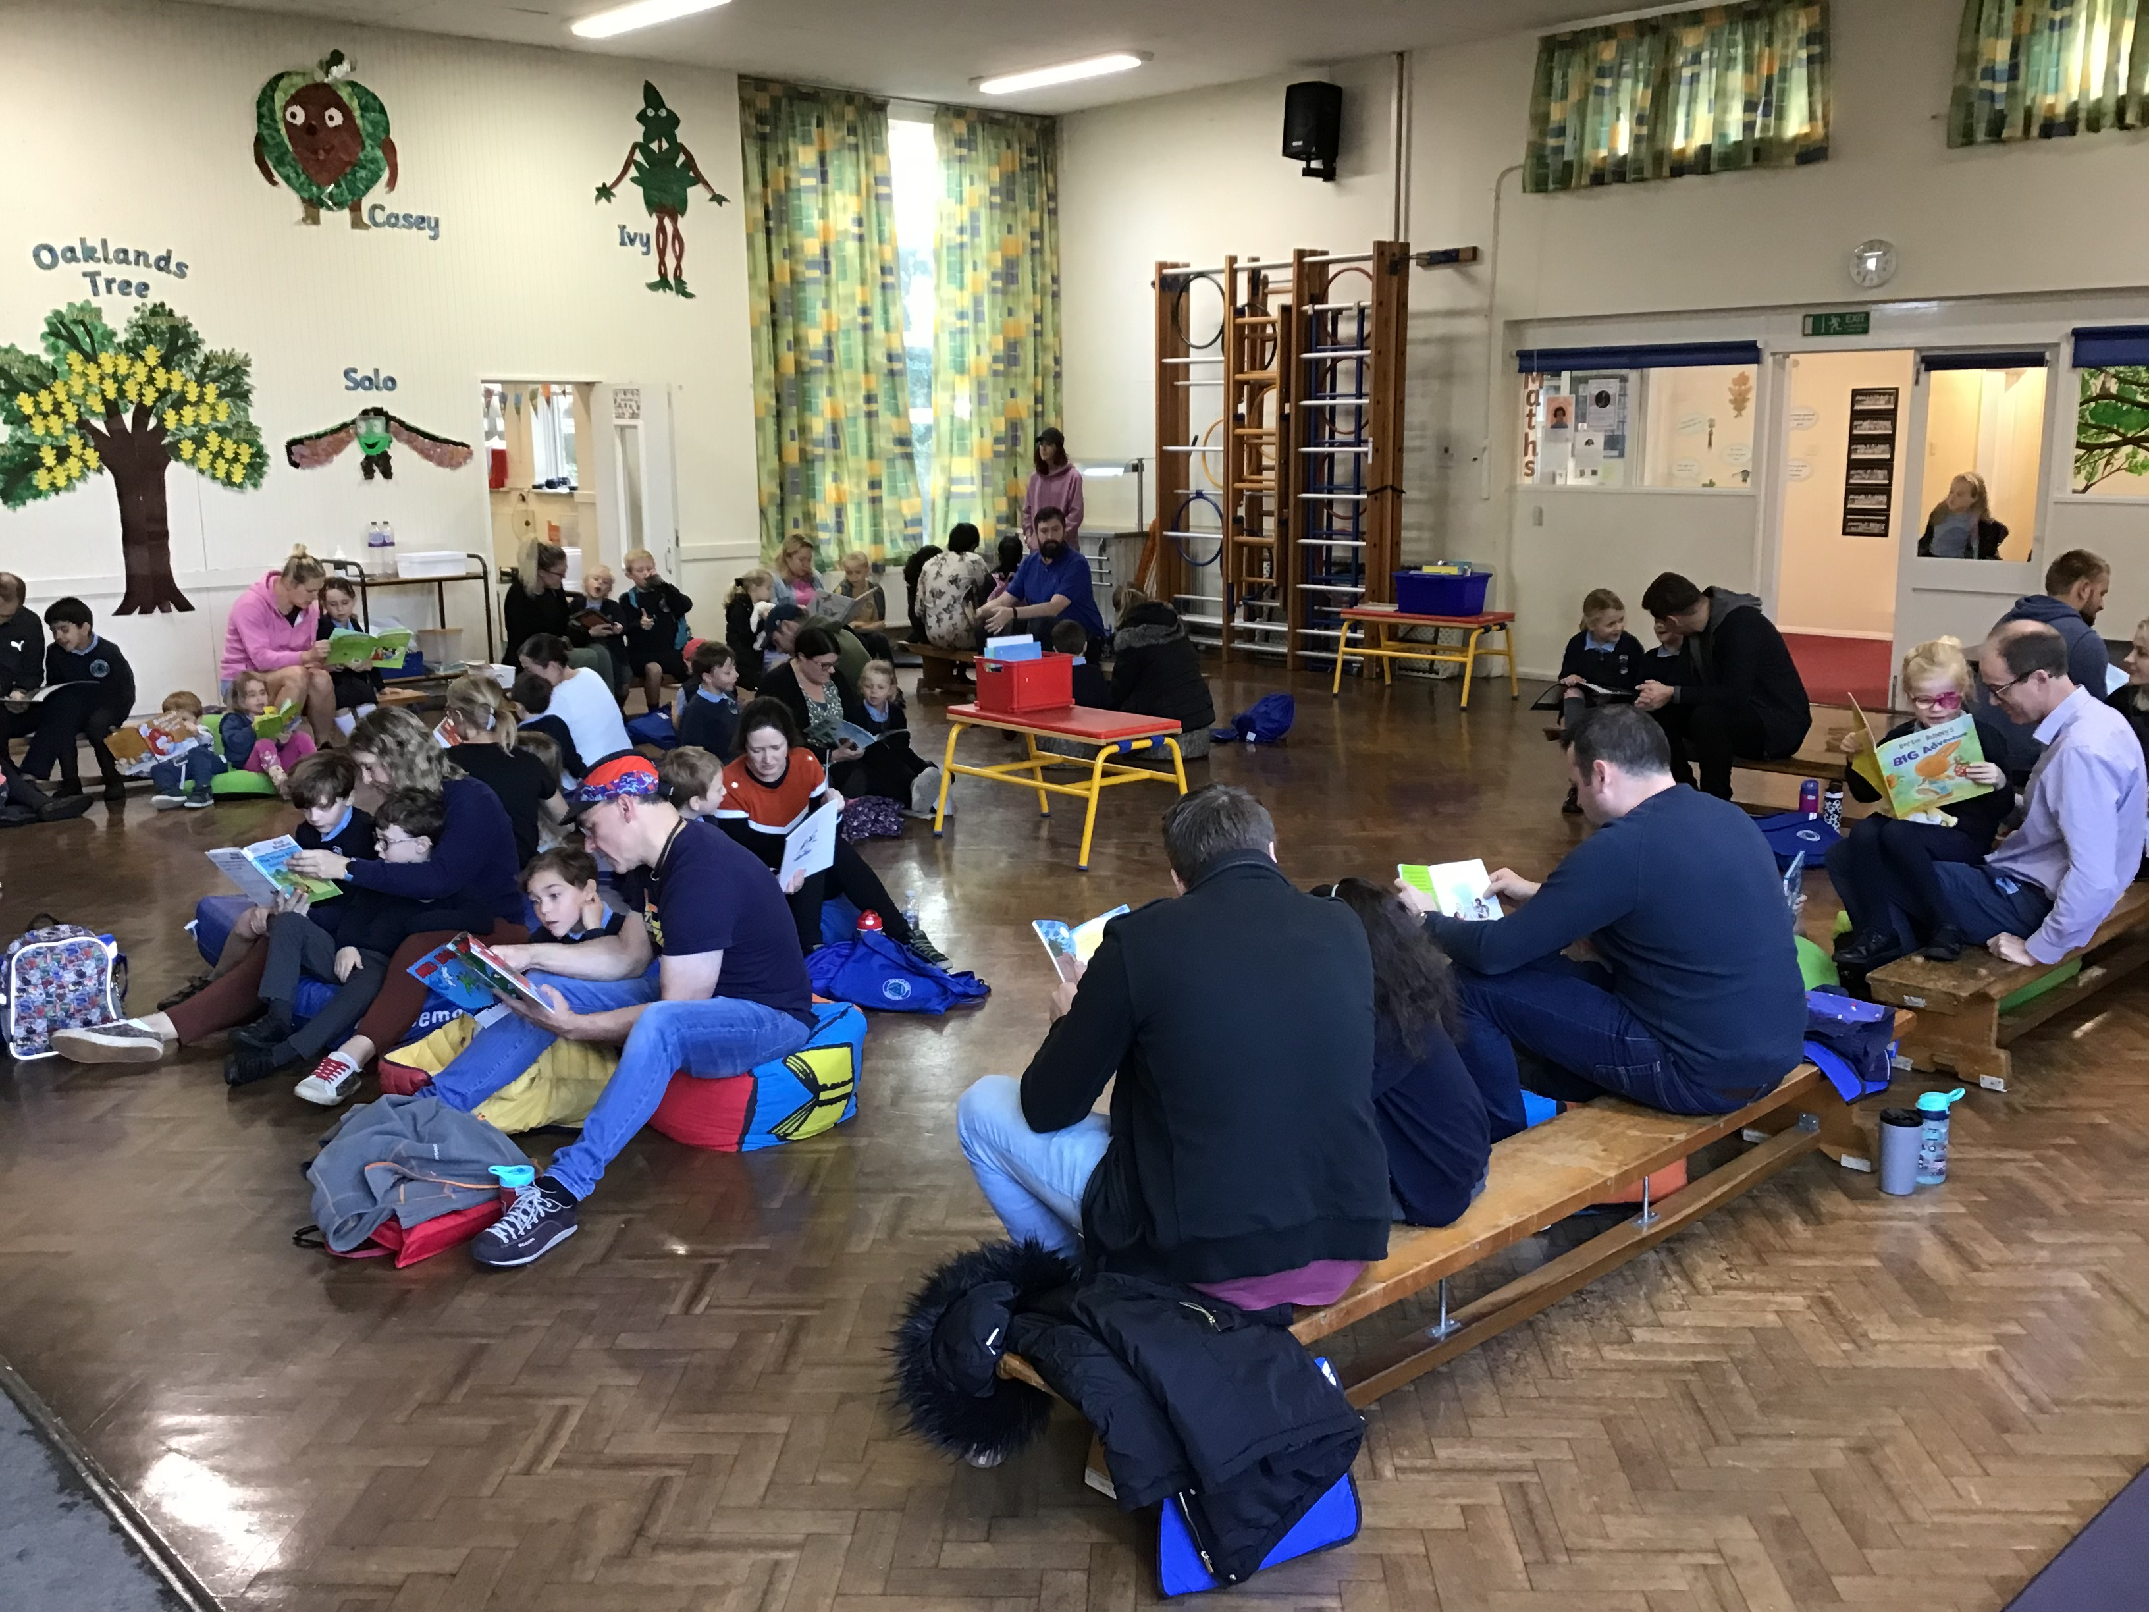
Reading for pleasure
Wednesday 18th November 8:15-8:35am

Slide 12
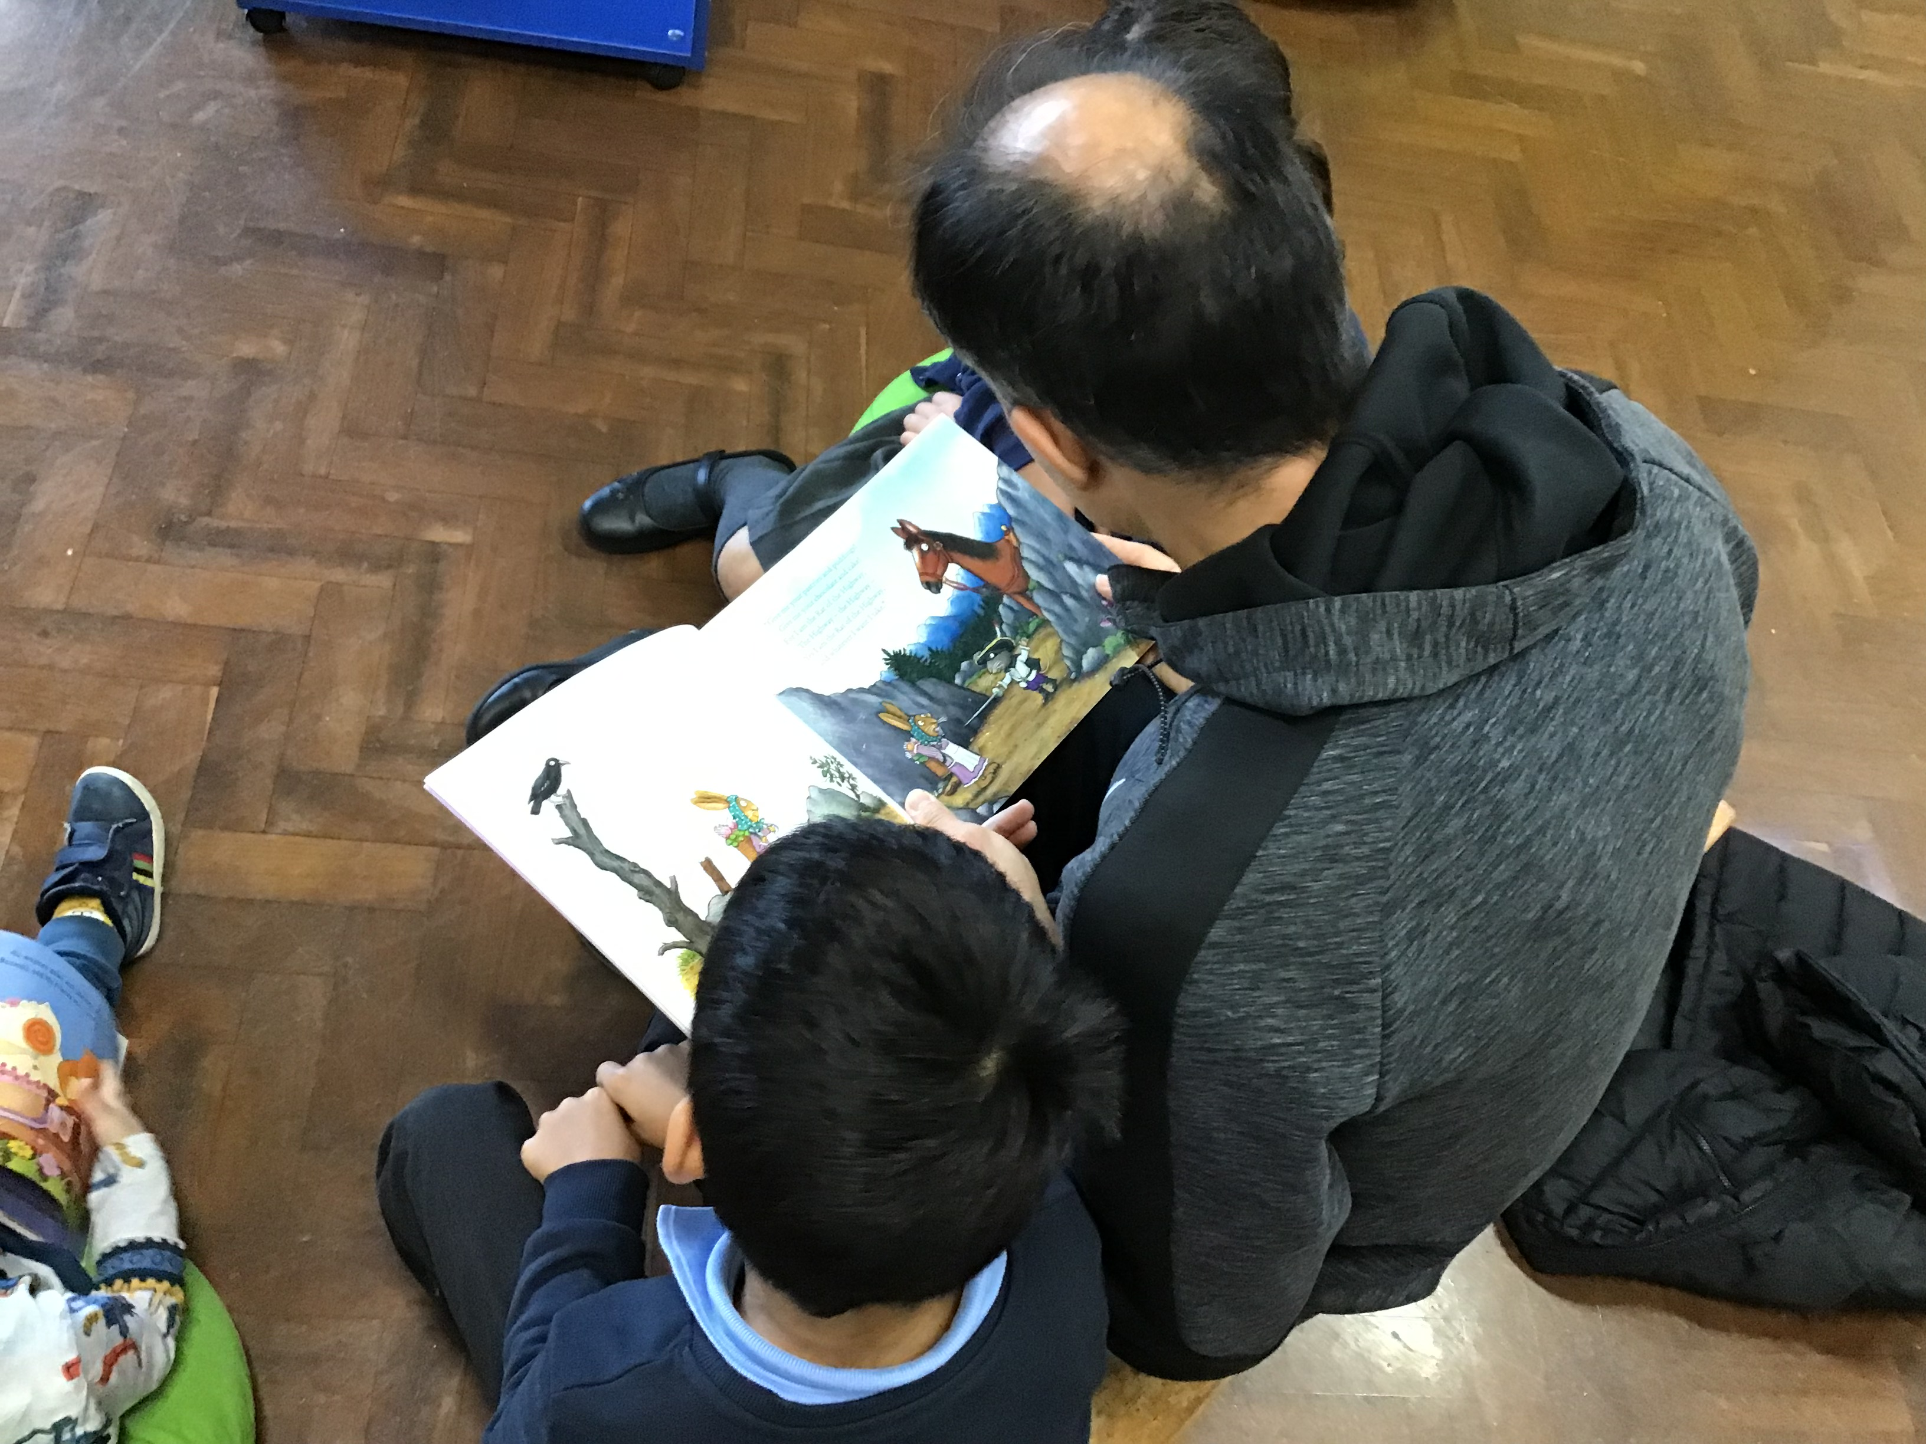
The Million word gap
Never read to | 4,662
1-2 times per week | 63,570
3-5 times per week | 169,520
Daily | 296,600
5 books a day | 1,483,300
The number of words children will have heard by the age of 5.
Science Daily 2019 quoted in The Reading Framework DfE July 2023

Slide 13

I am a Clever Writer
End of year one expectations
I can re-read what I have written to check that it makes sense.
I can write some sentences to form short narratives.
I can use a tripod pencil grip.
I can form my lower-case and capital letters correctly.
I can use a capital letter at the beginning of a sentence.
I can leave spaces between words.
I can use ‘and’ to join two sentences.
I can spell 80% Year 1 everyday words.

Slide 14








Stories to inspire writing

Slide 15

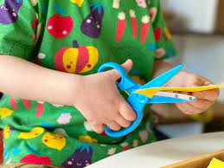
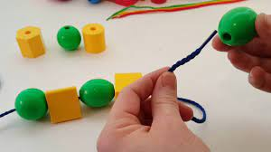
Handwriting
Fine motor skills.
Pegs
Playdough
Scissors
Threading
Colouring
‘Pinch and rest’ pencil grip
http://oaklandsinfants.org/handwriting/

Slide 16
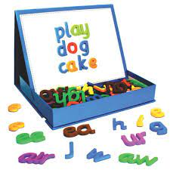
Spelling
List from English National Curriculum
Sent home regularly and will be assessed at school.
Roughly matched with sounds/spellings being taught.
Say the sounds as you write the word.
http://oaklandsinfants.org/phonics-2/

Slide 17

Maths
  www.ncetm.org.uk/teaching-for-mastery
  www.whiterosemaths.com
We use a maths mastery approach.
A mathematical concept or skill has been mastered when a child can show it in different ways, use mathematical language to explain their ideas and independently apply the concept to new problems in unfamiliar situations.
The emphasis is on keeping the class together until specific concepts or skills are mastered and then moving on together.
The children will bring home Key Instant Recall Facts KIRFs each half term on which they will be assessed at the end of the half term.

Slide 18
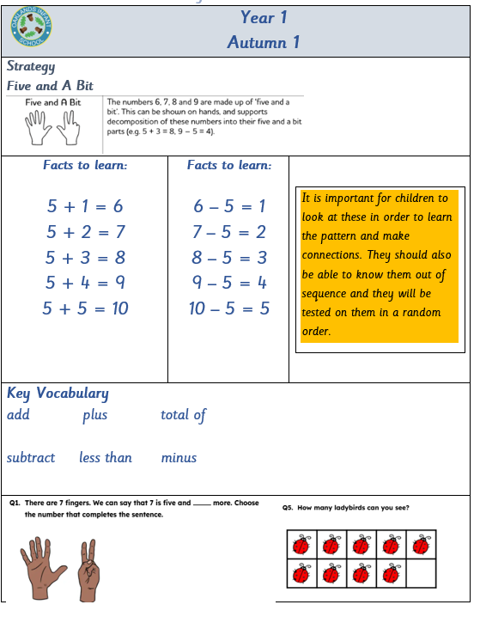

Slide 19

End of Year one expectations in maths.
Count within 100, forwards and backwards, starting with any number
Develop fluency in addition and subtraction facts within 10
Count forwards and backwards in multiples of 2, 5 and 10, up to 10 multiples, beginning with any multiple, and count forwards and backwards through the odd numbers
Read, write and interpret equations containing addition (+), subtraction (-) and equals (=) symbols, and relate additive expressions and equations to real-life contexts.
Recognise common 2D and 3D shapes presented in different orientations, and know that rectangles, triangles, cuboids and pyramids are not always similar to one another.
How can you help?
Number bonds
Card games, board games, dice games
Talk to your child when shopping. Physical money
Cooking
Look for shapes around the house or when out for a walk

Slide 20

A positive Learning Environment!
Our approach – The Oaklands Way
Marble jar
Star of the week.
Character leaves given in assembly. Afternoon tea with the headteacher, leaf on the tree in the hall.
Leaf comes home each half term for you to complete with how your child has shown those characteristics at home.
We will send a leaf home for you to add how your child is showing that characteristic outside of school.
If staff contact you regarding behaviours concerns we would appreciate your support to reinforce our school expectations and help your child make positive choices.

Slide 21
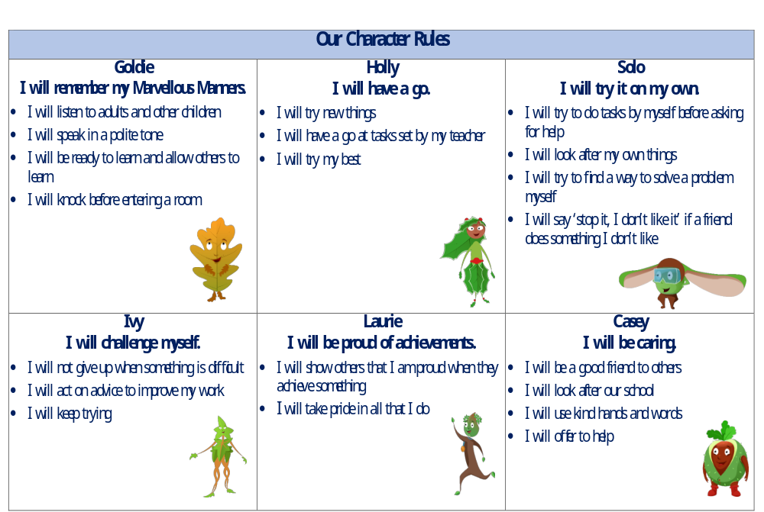

Slide 22
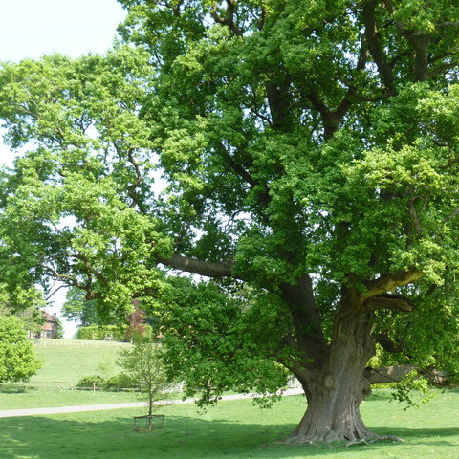

School Termly focus…
Autumn 1 – Goldie
Autumn 2 – Holly
Spring 1 – Solo
Spring 2 – Ivy
Summer 1 – Laurie
Summer 2 – Casey
http://oaklandsinfants.org/visions-and-values/
This Photo by Unknown Author is licensed under CC BY-SA

Slide 23

Our Topics in Year 1
  Year one topics
  All About Us Reminder: 3 photographs of your child A6 on paper – baby, toddler, now
  Walk on the Wild Side
  Christmas
  Lower the Drawbridge
  And it grew…,
  Far, far away
  Toy Story
  Seasons

Slide 24

Visits and visitors & approximate costs
Autumn term
Harvest festival donations to the local foodbank
Local walk
PTA non- uniform £1
Poppy appeal
Children in Need
Fireworks PTA
Pantomime – alternately in school or at the theatre – last time - £21.50
Christmas play maybe an appeal afterwards
Elfridges PTA
St John’s church, carol service
Spring term
Windsor Castle – last time £20.50
Library
Summer term
Walk to Bucklers Park
Milestones Museum- £20
Crazy hair day PTA
After/before school sports activities/chess/music lessons

Slide 25
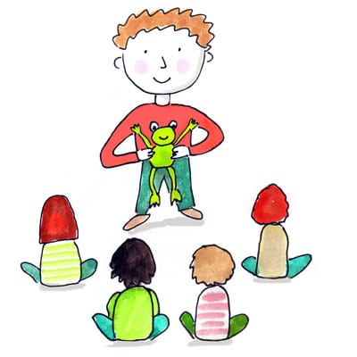
Show & tell
Autumn 1 – a holiday picture/map/postcard/souvenir
Autumn 2 – -my favourite animal
- a photograph of something special for RE
Spring 1 – a favourite book
Spring 2 – topic related – plants and trees
Summer 1 – topic related – geography – China/other countries
Summer 2 – a picture of favourite toy/any information about toys from parents/grandparents
Please talk with your child about what they might say and prepare them to speak to an audience.

Slide 26
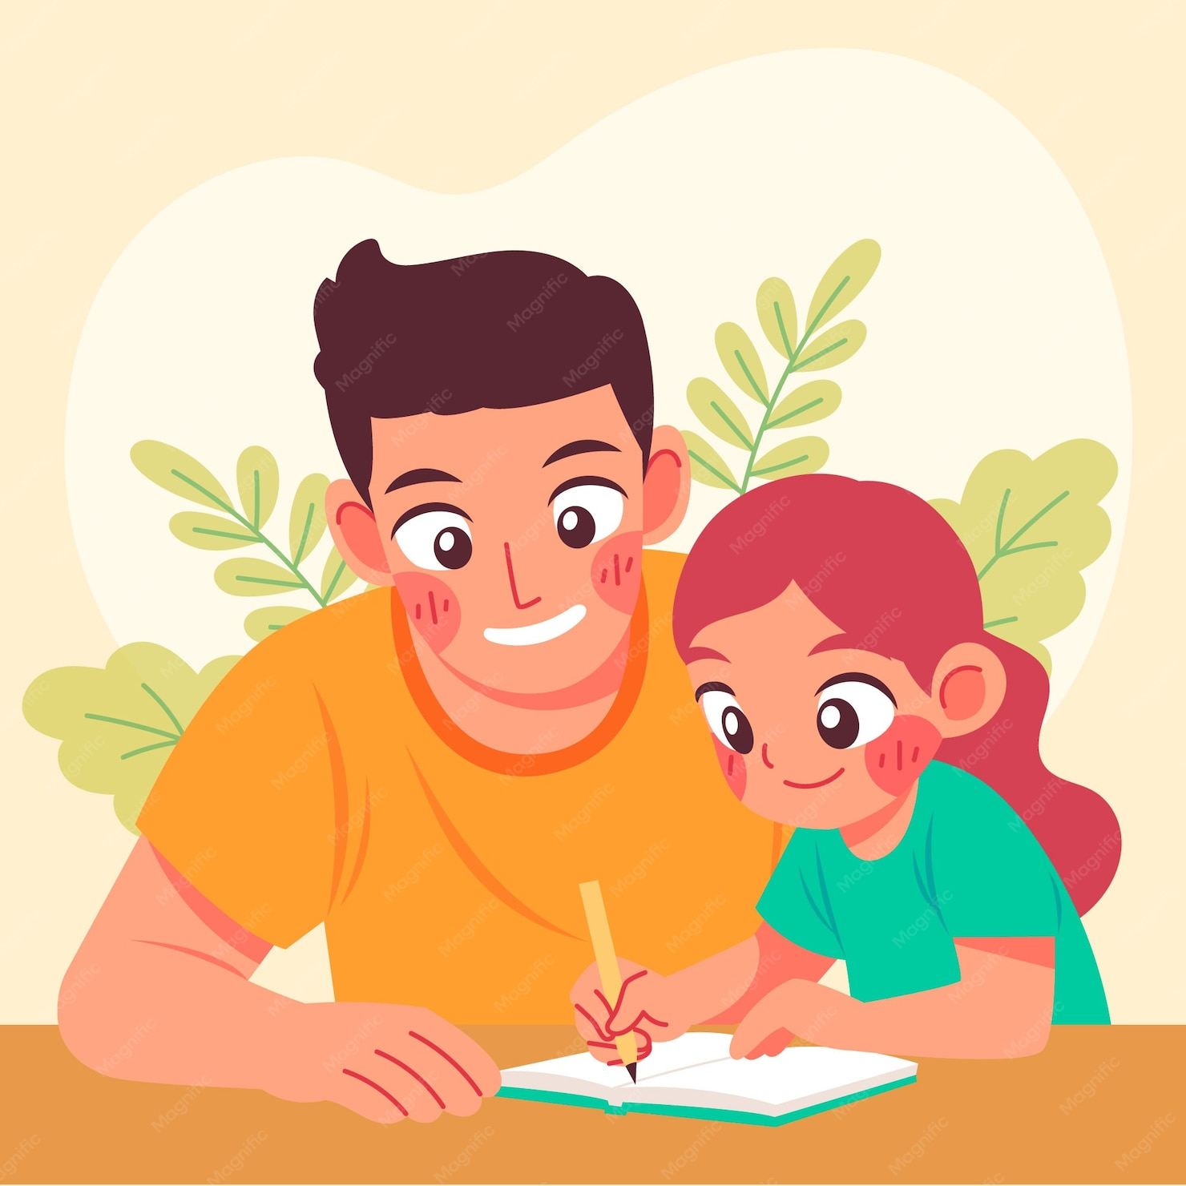
How can you support your child?
Have a routine
Read to your child
Read 4/5 times a week & sign reading record book every time.
Use the home learning sheets
After a topic talk about what is on the knowledge organiser
Review maths key facts frequently
Play board/dice/card games
Cook together, lay the table, plan an event together
Volunteer – library/gardening/PTA/reading guardians/play board games
Come to – Reading for Pleasure events
      Parent evenings (last week before October & Feb half term)
      Celebration of learning
      Assembly – spring term
      Christmas play

Slide 27

Whatsapp groups
Can be useful for sharing information but can sometimes lead to misunderstandings
We encourage you to speak directly to the class teacher if you have any questions or concerns
Please remember courtesy and respect when communicating within these groups
Parent representatives
We are looking for a parent representative for each year group.
The Parent Class Representative role helps to strengthen communication between families and the school. We are looking to appoint one representative for each class. One name to put forward to the school office by Wednesday 23rd September.
Coffee morning
This will be an opportunity to hear about the school’s priorities for the year, meet the Assistant Heads and connect with other parents.
Wednesday 23rd September.

Slide 28

Where can you find information?
Our door is always open. Please come and talk to us at the end of the day.
School website
School emails
Home Learning sheets
Parents’ evening
Newsletters
Celebrations of Learning
WEDUC

